Slide 1
The Journey
Dramatic Images
Water
People and Possessions
Mixed Media
Performing arts
Patterns
Issues and Observations
Pick one of the key words and produce a mini project either in a sketchbook or as a digital powerpoint. Please look at this powerpoint to help you. You can also use the template slides as a guide.
1- Research your key word and find inspirational artists and sources. (2 pages/slides)
2- Take pictures that link to your keyword and artist research. Add these pictures to your powerpoint or sketchbook. (use your camera phone) (2 pages slides)
3- Evaluate your work. (1 slide/pages)

Slide 2
Artists. Evaluate an image or images.
Content: What is the work about? Does it address any social, religious or political issues?
Formal Elements; What formal elements are prominent? Colour, Line, Space, texture, pattern, aperture, Shutter Speed, Macro, Sharpness, Rule of thirds
Techniques used: If a photograph what techniques do you think were used to take it?Aperture, slow/fast, movement blur, iso. White Balance, flash, multi flash, background light, rim light, hard, soft, fill light, gels, snoot, light trails, high speed sync. Editing: split toning, clone tool, vignette.
The Expressive: What mood and Atmosphere is Created?How does it make you feel? Amused, melancholy, frightening, mysterious, frustrating, romantic, gloomy, Sentimental, sorrowful, joyful, angry, playful,sad, serious,

Slide 3
Add your pictures here

Slide 4
Evaluate your shoot.
Artists: Which artists inspired your work? Place a key image here. How did they inspire your work?
Ideas: What were your ideas behind the shoot? Were they successful? Why?
Techniques: How did you create the work? Evaluate the techniques used.
Conclusion: Evaluate what was successful about the shoot? Which techniques worked best and why. Next time what would you do differently and why?

Slide 6
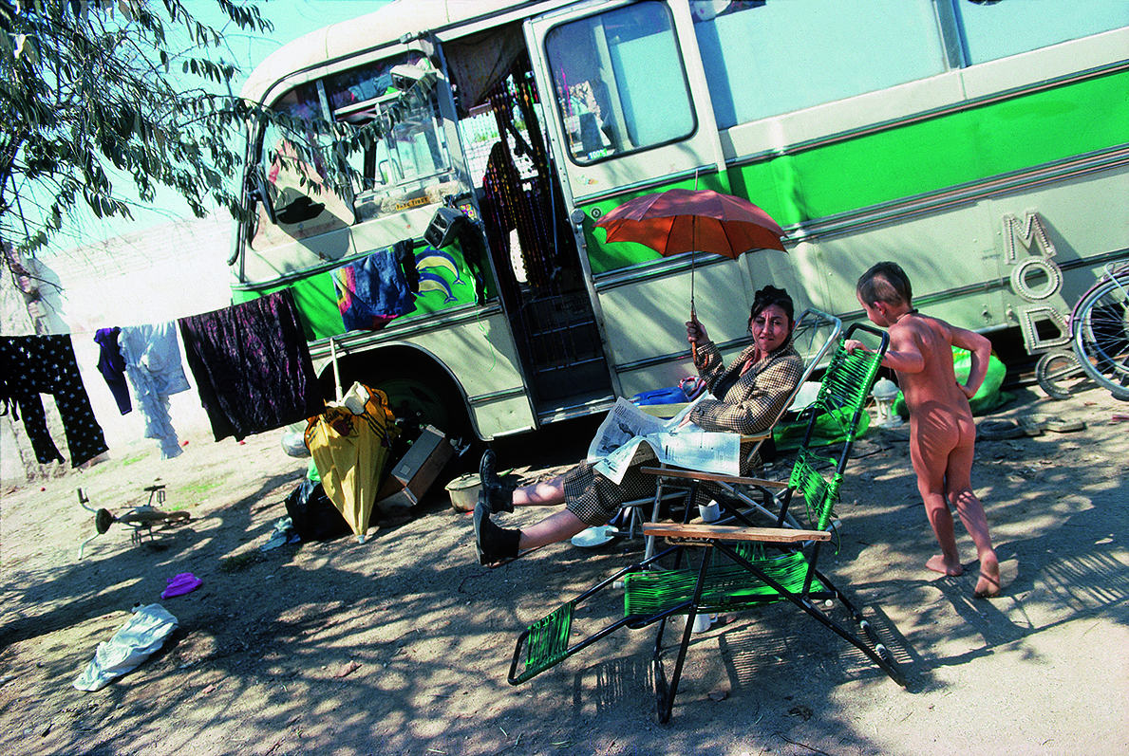
<<< Hunter lived as a traveller for several years and documented the lifestyle as he journeyed around Europe.
Tom Hunter
From ‘Travellers’

Slide 7
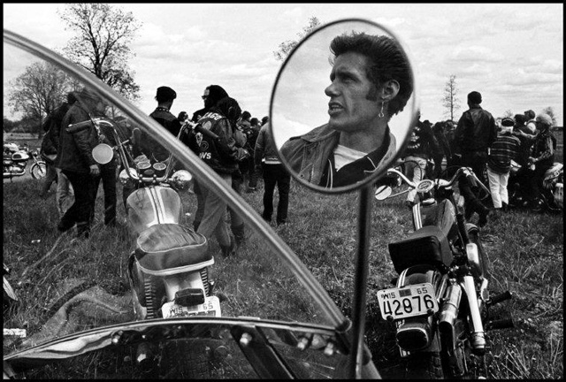
<<< An amazing documentary project exploring the life of bike gangs.
Danny Lyon
From ‘The Bikeriders’

Slide 8
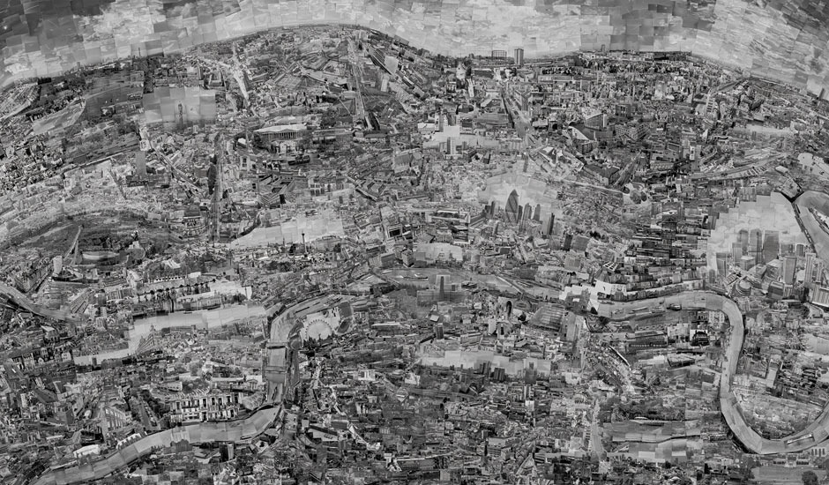
<<< Nishino travels around a city photographing landmarks that interest him.
He then uses these images to create his own map of the city as a huge diorama.
<<<
Each segment is a standard size 6 x4” print!
Sohei Nishino – from ‘Diorama Maps’

Slide 9
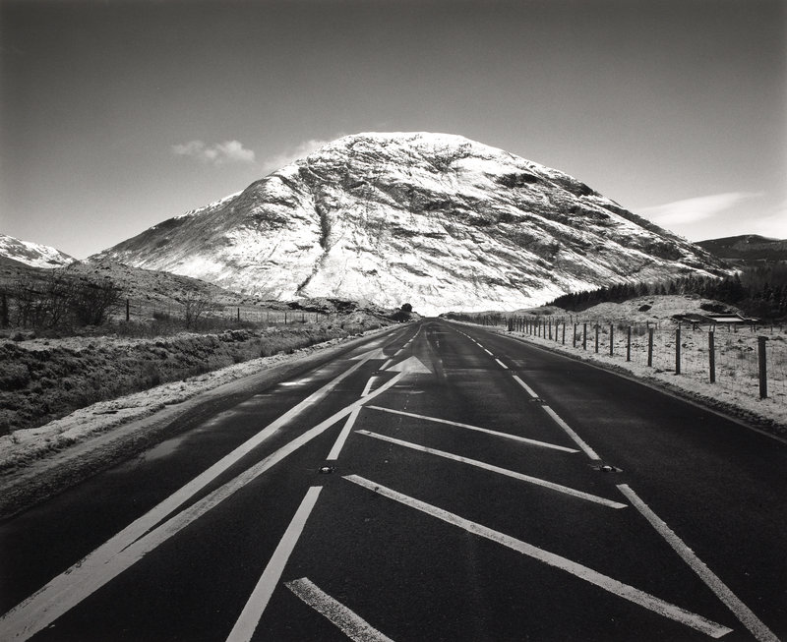
<<< Godwin is interested in the landscape and how we travel through it.
She is a passionate walker and much of her work is made around the process of walking and exploring the countryside.
<<< Roads and leading lines etc can be an effective way to represent travel.
Fay Godwin - Meall Mor

Slide 10
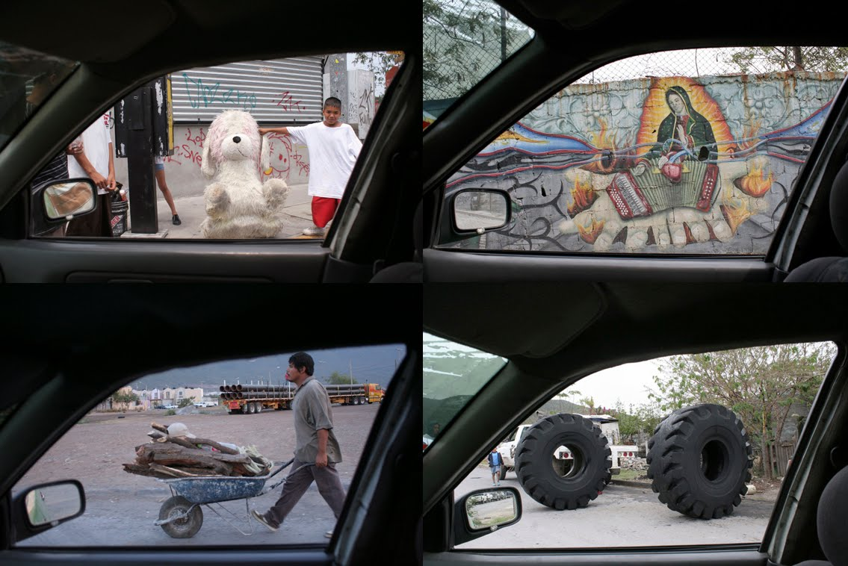
<<< This photographers job is a journey, he is a taxi driver.
He shoots images he spots through his window as he travels around Mexico City.
Oscar Fernando Gomez

Slide 11
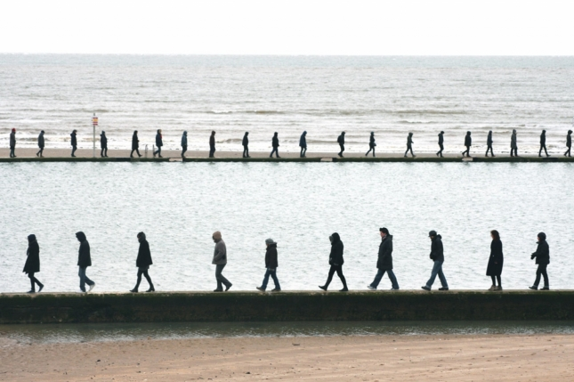
<<<Fulton is one of the best known ‘walking artist’.
His work is as much about the process of the journey as it is the work he creates at the end of it.
Hamish Fulton – from Kent Walking series

Slide 12
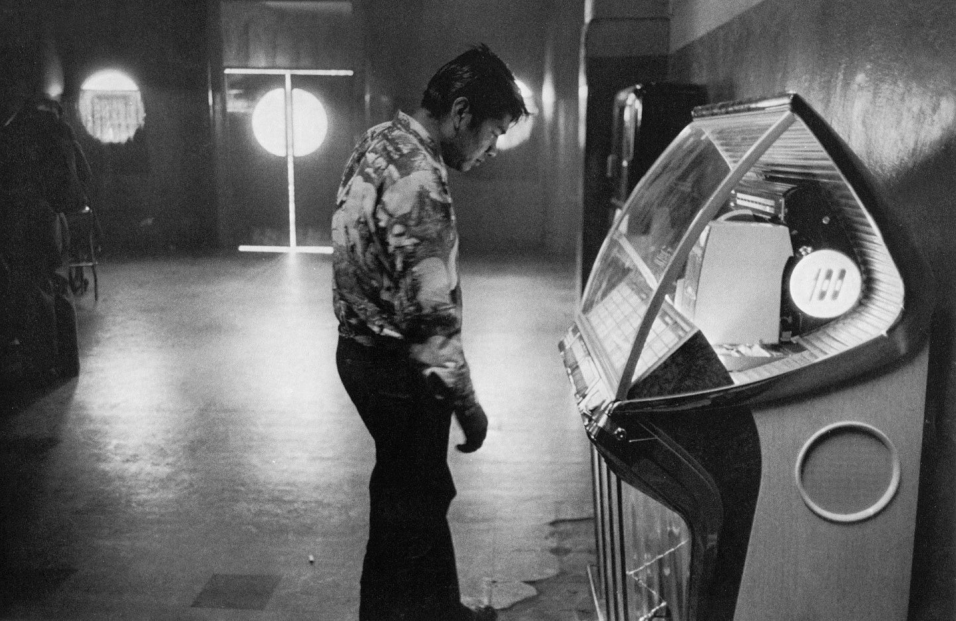
<<< The Americans is arguably the most significant body of work based around a road trip journey. Travelling across America documenting the people and culture.
Robert Frank
‘The Americans’

Slide 14
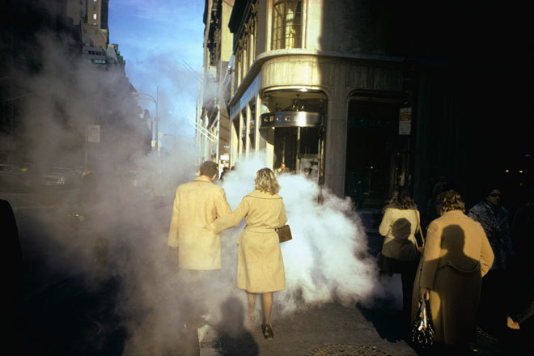
<<< Amazing use of natural light in street photography to create a dramatic image which singles out certain ‘characters’.
<<< Nice bit of colour matching too!
Joel Meyerowitz

Slide 15
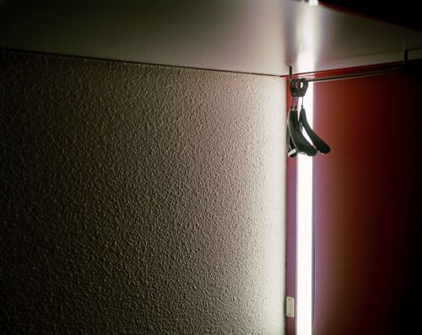
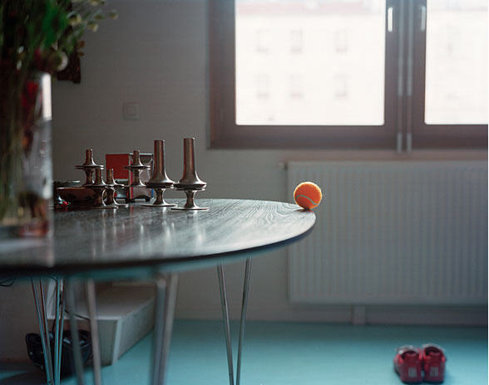
Stunning images created around the house using everyday objects and strong natural light to elevate the scenes to something more intimate and emotional.
<<<
Gerald Garbez from An Intimate Fiction

Slide 16
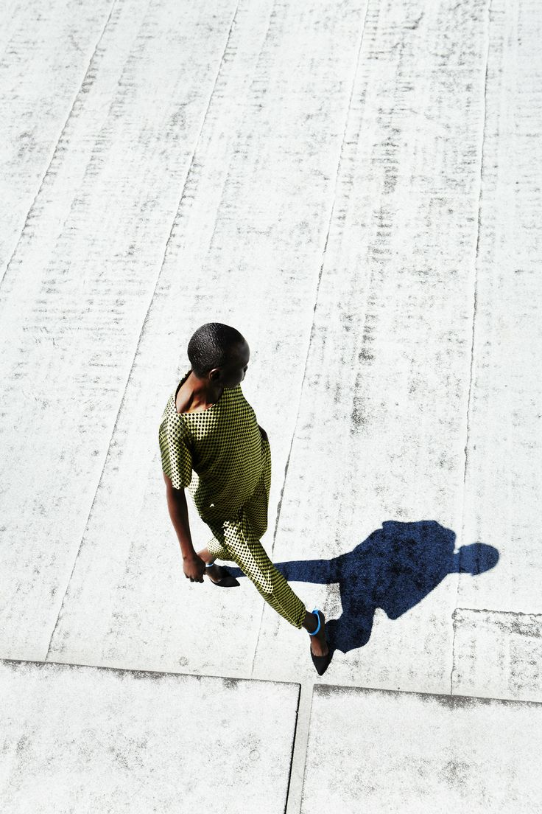
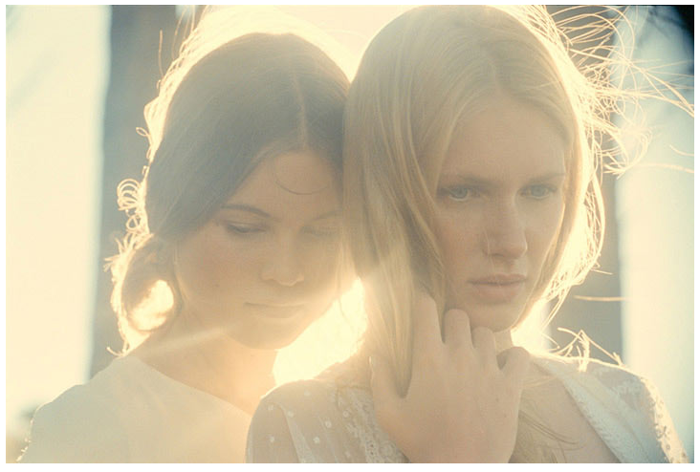
Great examples of using strong natural lighting outside and creative camera control for dramatic fashion images.
Benjamin Alexander Huseby
Jem Mitchell

Slide 17
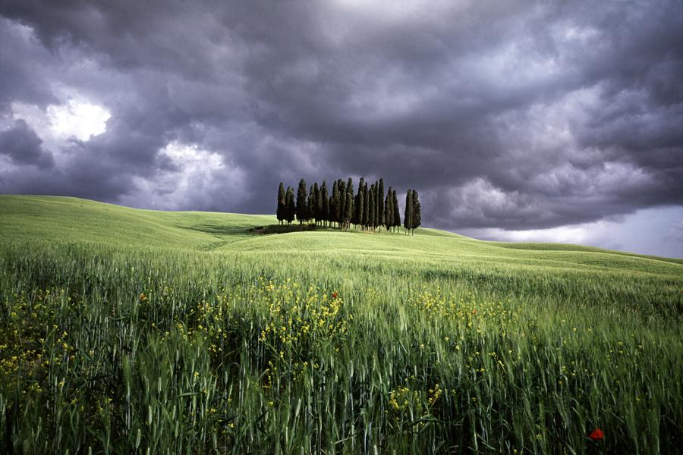
<<< Charlie Waite is one of the most renowned landscape photographers in the UK. His images are often about dramatic lighting – perhaps exaggerated through use of filters?
Charlie Waite

Slide 18
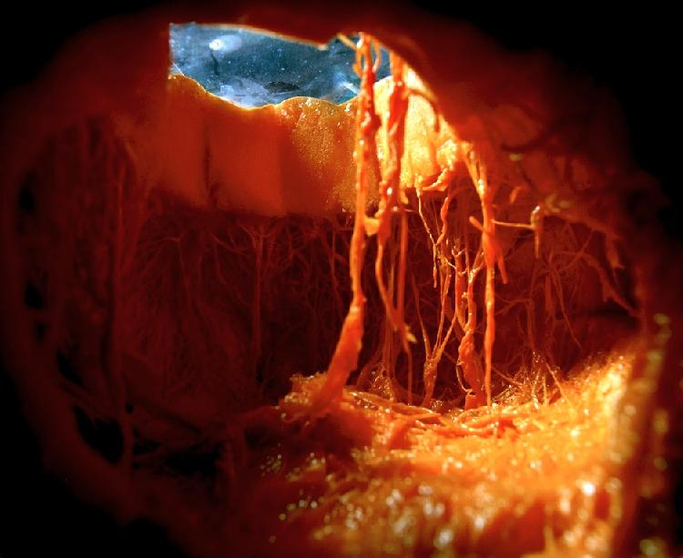
<<< The view from inside a pumpkin! It involves the available light coming in through the top and creates a surreal and striking photograph.
NADEGE MERIAU

Slide 19
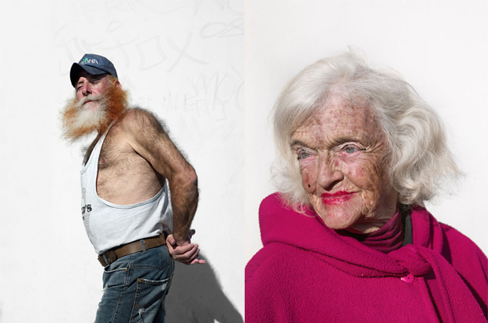
<<< Katie Granan’s epic portrait series use the harsh light of the L.A sunshine along with white walls and very well chosen subjects.
Katie Granan

Slide 20
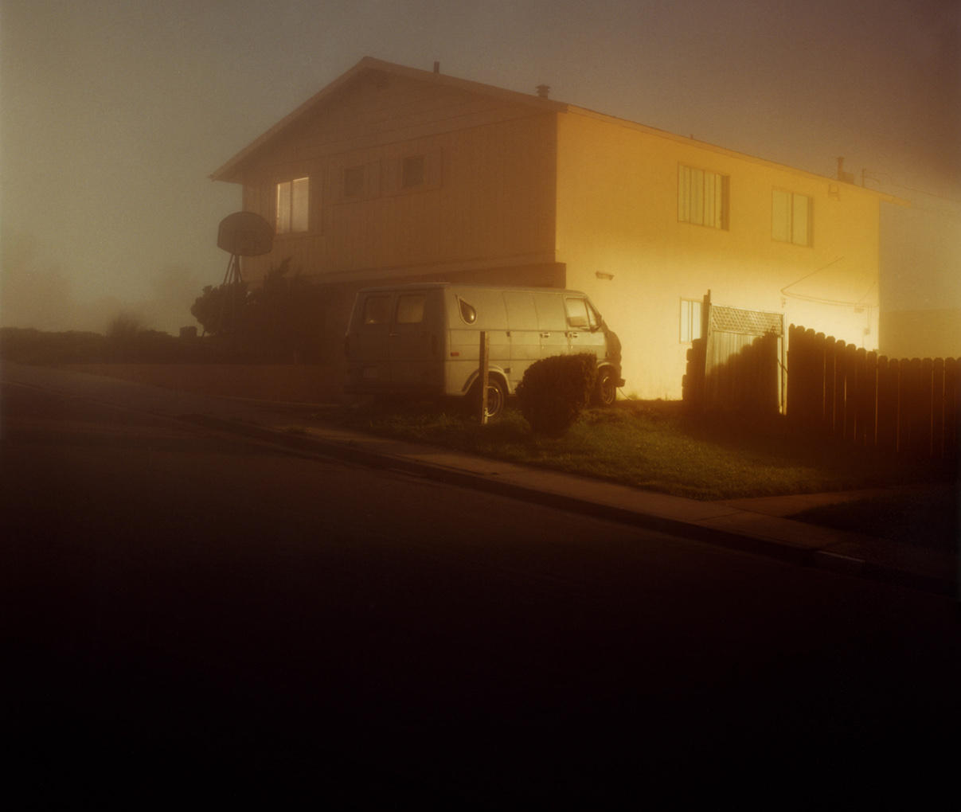
<<< Todd Hido uses available light in many creative ways. This series saw him photographing American Suburbia at twilight to create an eerie and beautiful light and colour pallet.
Todd Hido from ‘American Suburbs’

Slide 22
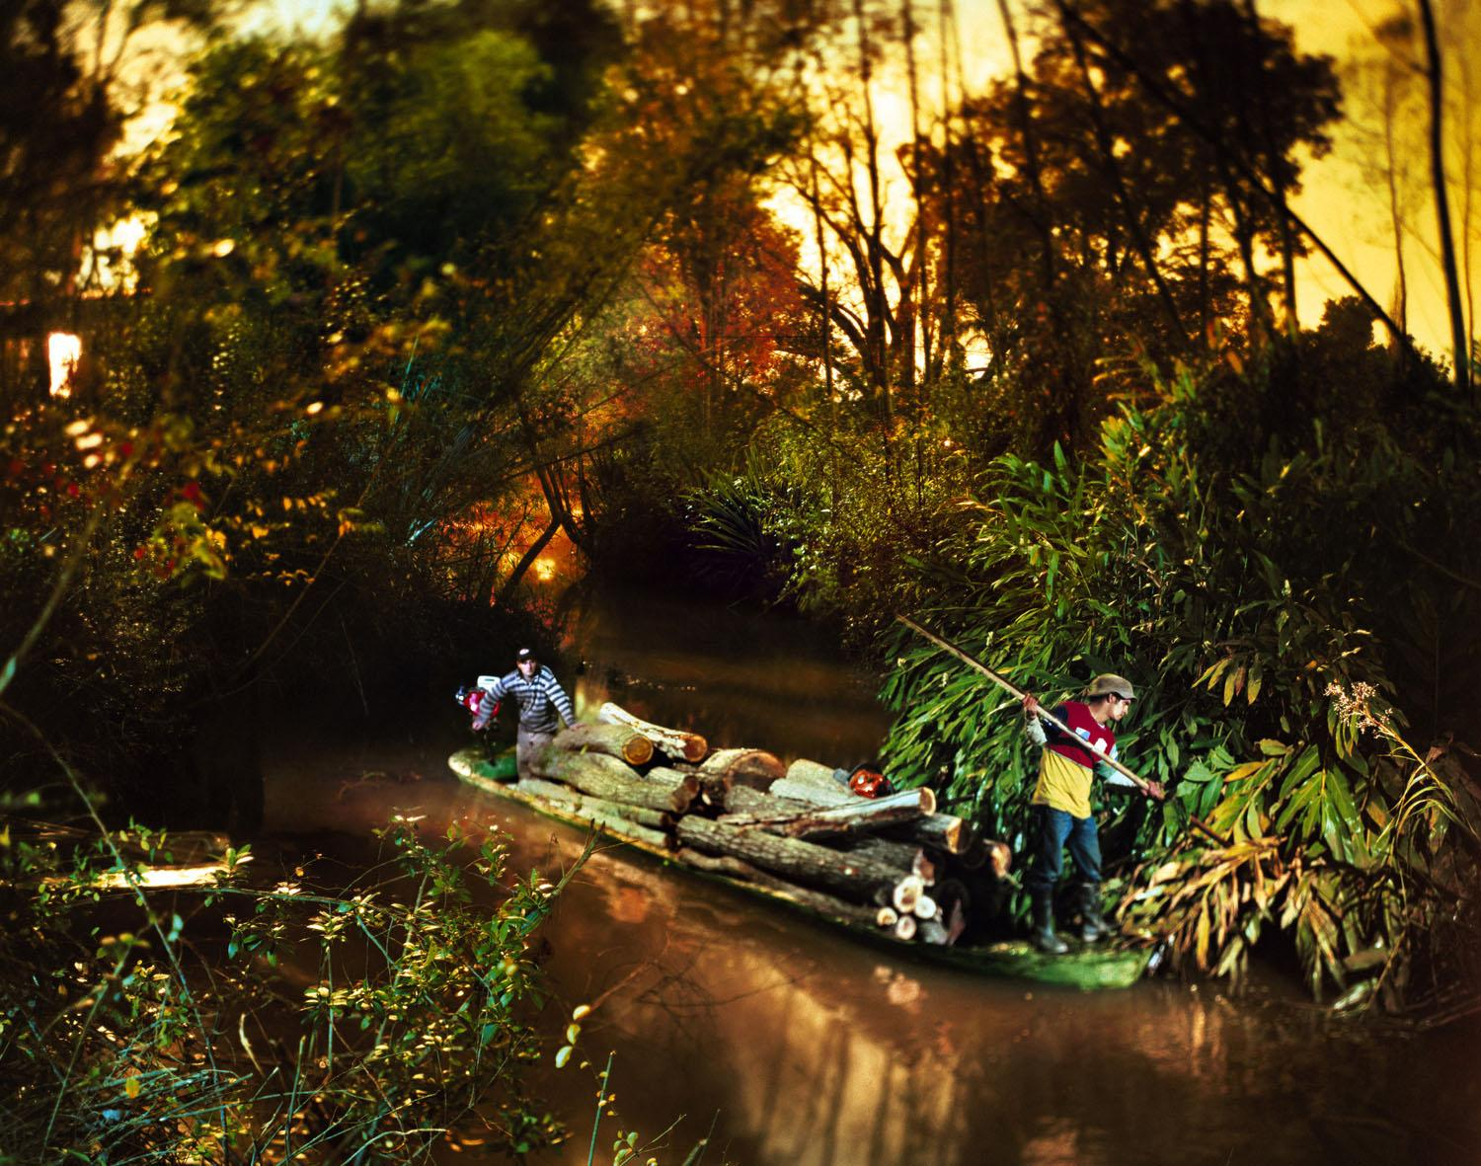
<<< Chaskielberg created these stunning images about a river in Argentina. He documented those whose lives revolved around the river.
<<< The strange focus is using a tilt shift effect on a Large Format camera.
Alejandro Chaskielberg

Slide 23
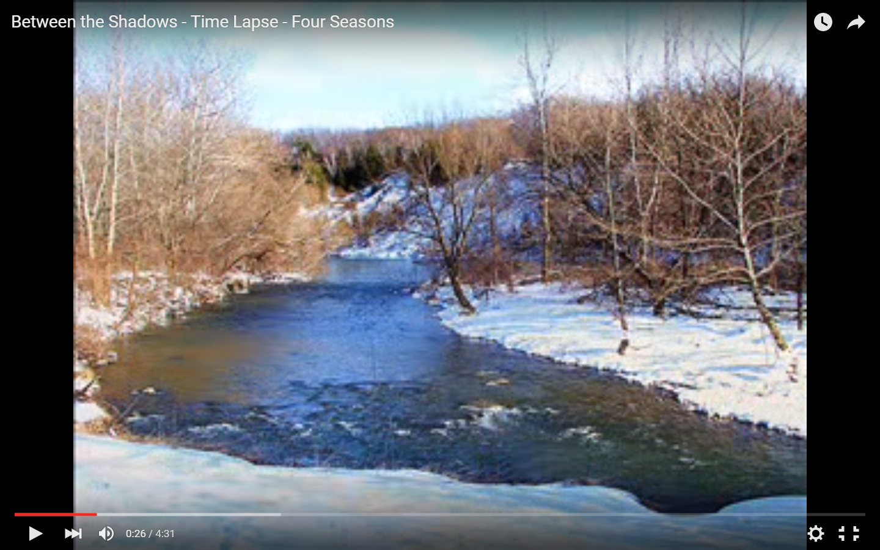
<<< This timelapse captures the changes in a river over the space of a year.
Johnny Martineau – timelapse of a river over a year. Click image to load video in Youtube.

Slide 24
<<< Sugimoto is fascinated by time and how he could take images of the sea that could be timeless and from any period.
The horizon is always exactly in the centre of the images.
They are printed at a huge scale and the sea has a different personality in each image.
Hiroshi Sugimoto

Slide 25
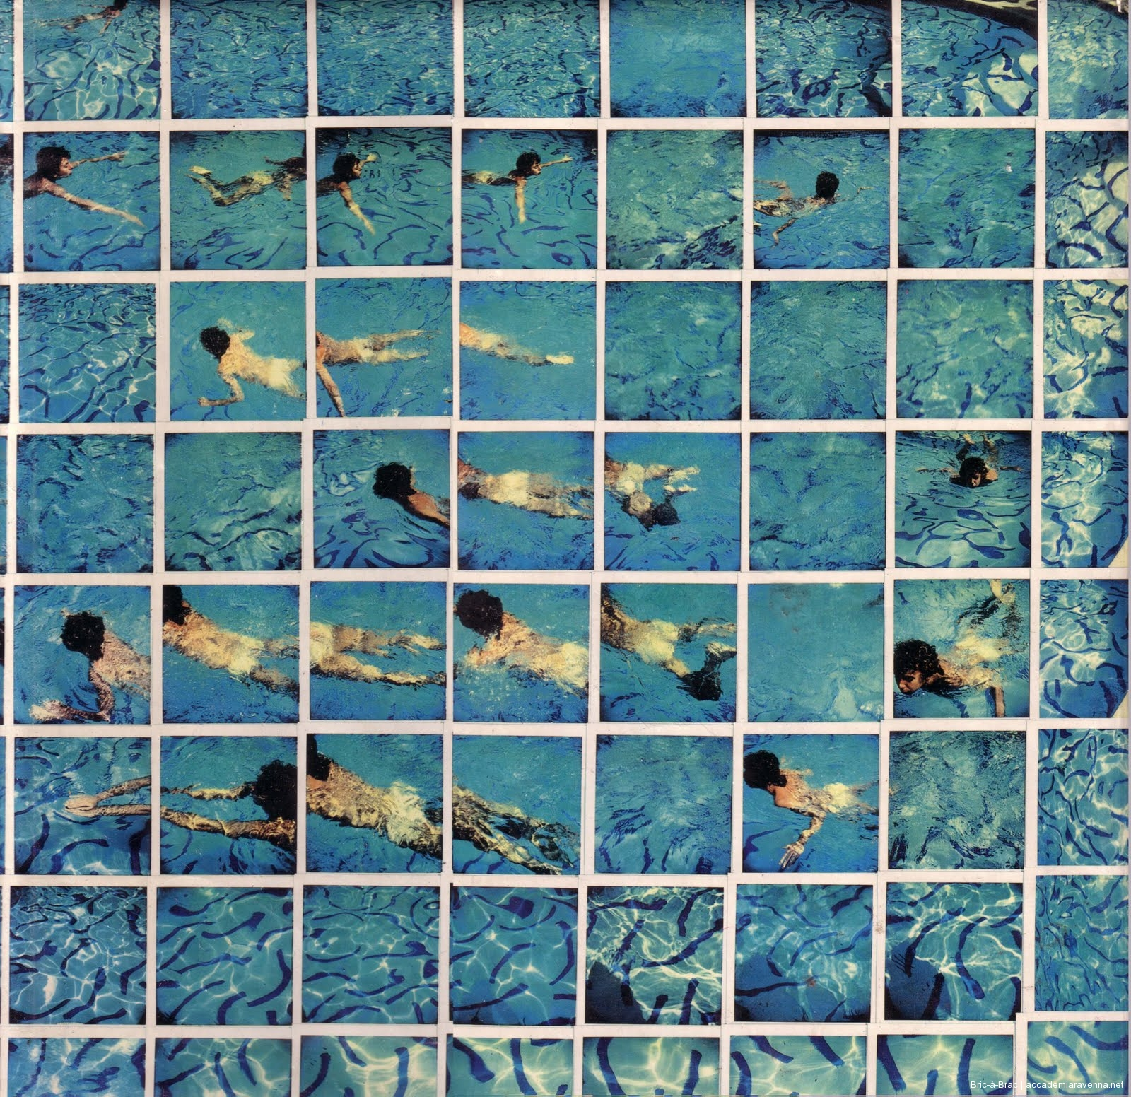
<<< One of Hockneys famous joiners.
He painted and photographed swimming pools and water at numerous points through his career.
David Hockney

Slide 26
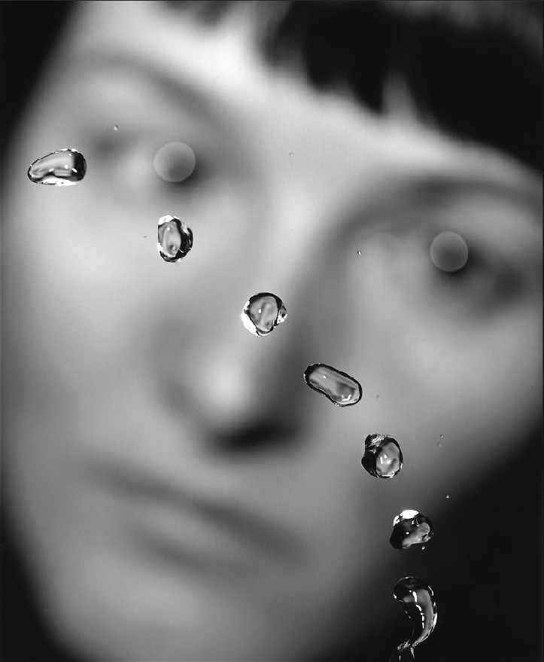
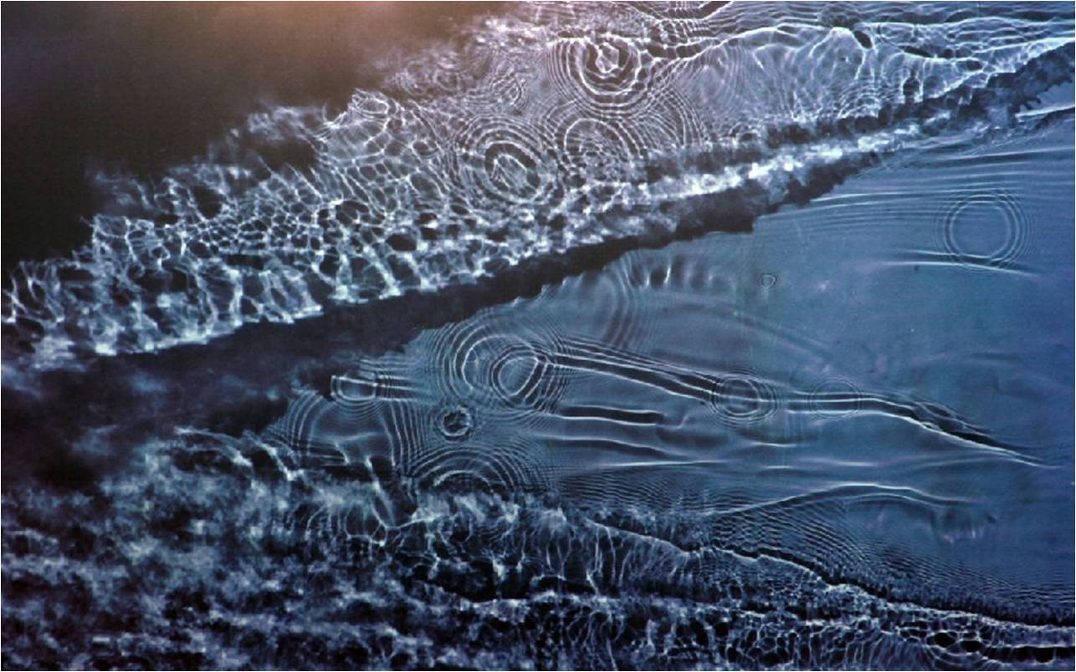
Dergess mainly works with Photogram techniques, including placing photographic paper under streams and rivers at night and allowing the moonlight to expose the paper.
<<<
Susan Dergess

Slide 27
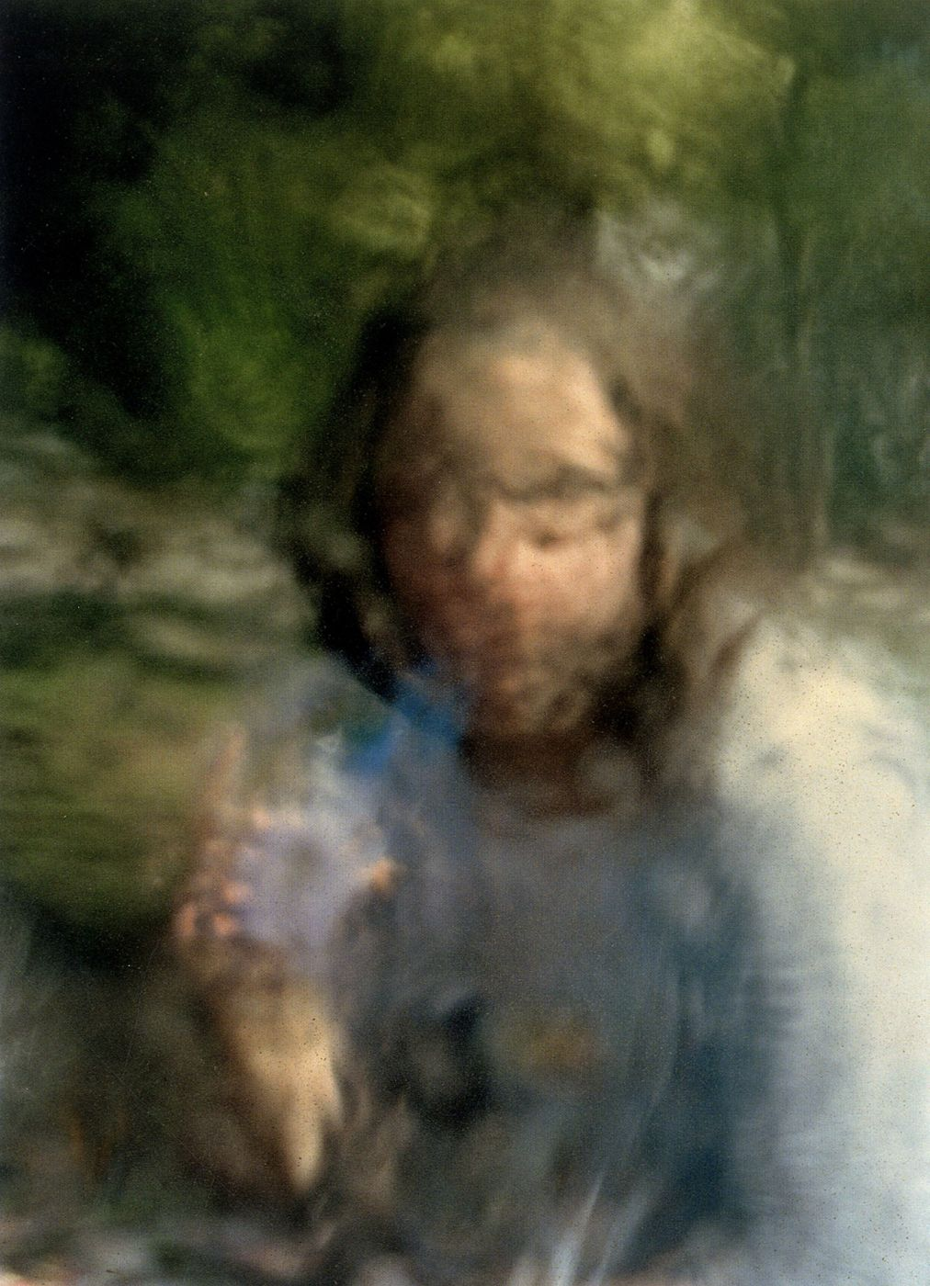
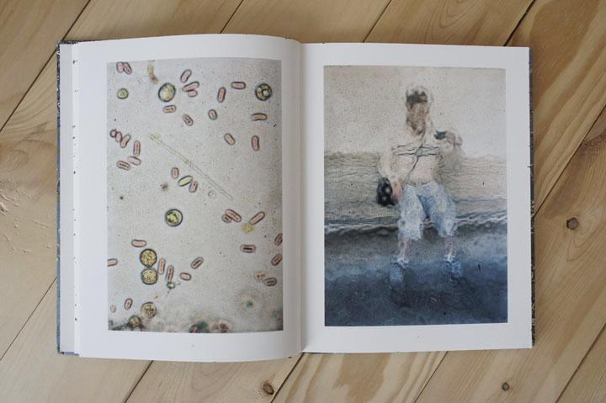
Gill was commissioned to create work about an industrial wasteland. He collected water samples from a pool and carried it around in a bucket. He would dip his lens into the water and then create portraits alongside microscopic photographs.
<<<
Stephen Gill - Coexistence

Slide 28
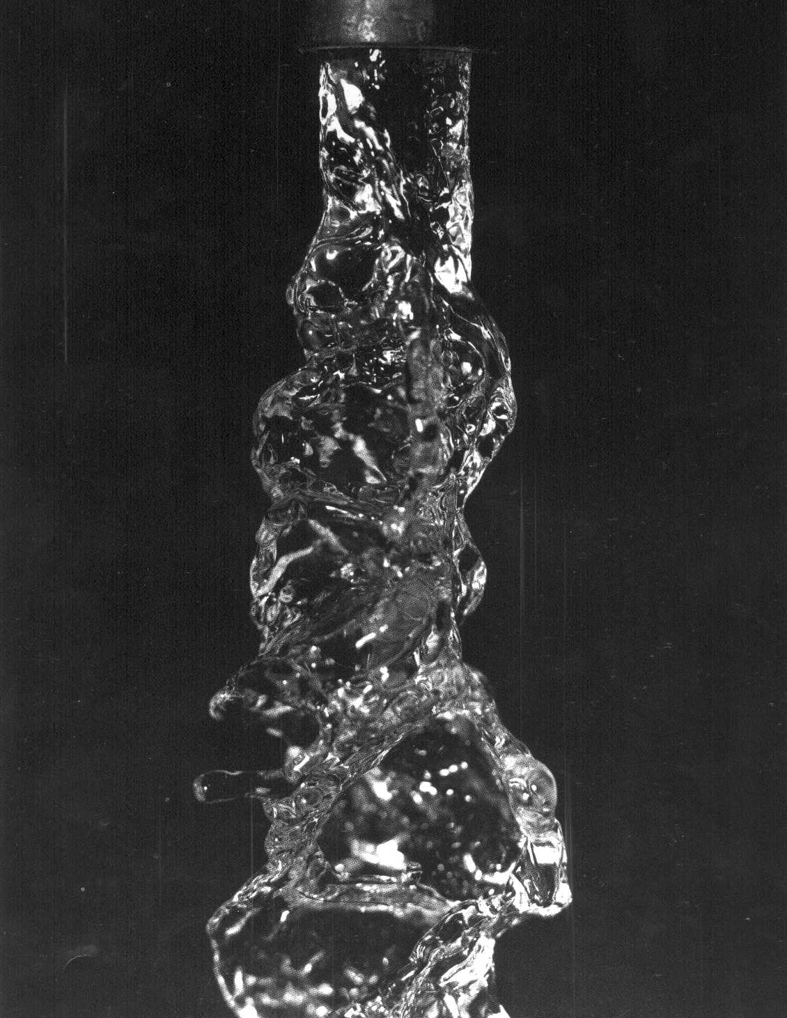
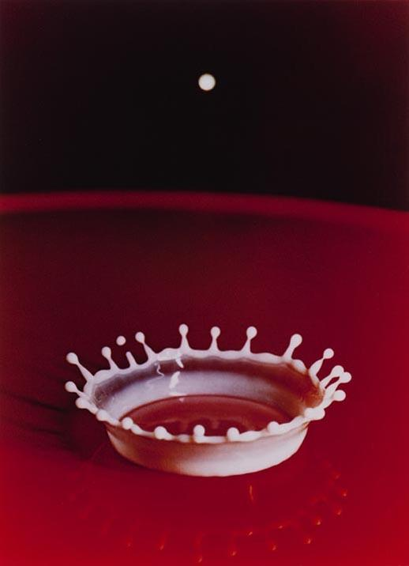
<<< Edgerton photographed things the eye could usually not see through slow shutter speeds and lighting.
Whilst this image is milk, it could be done with water and ink?
<<<
Harold Edgerton

Slide 30
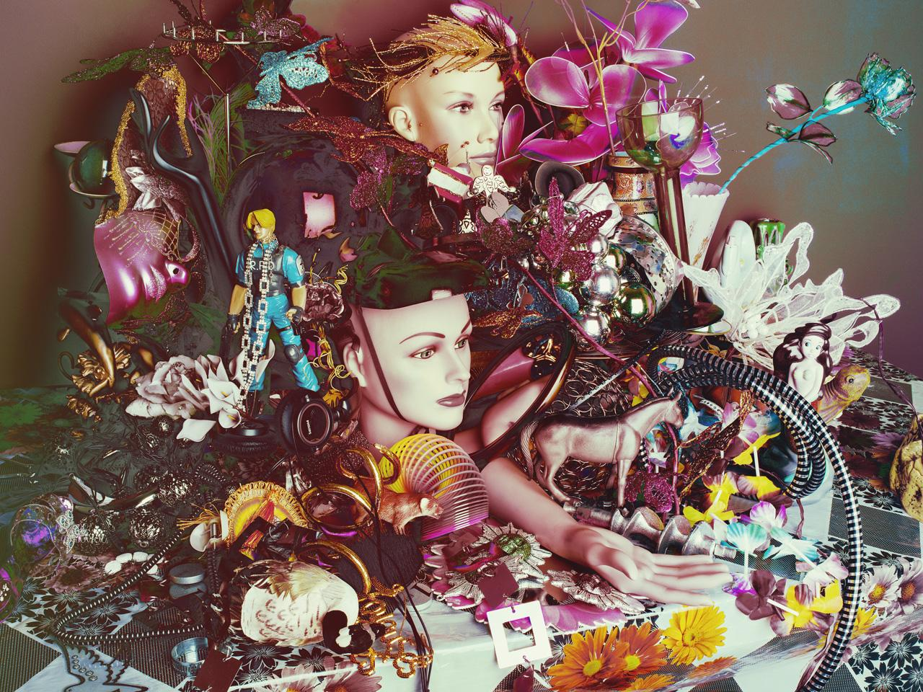
<<< Great still life creations used from using possessions and objects.
Valerie Berlin

Slide 31
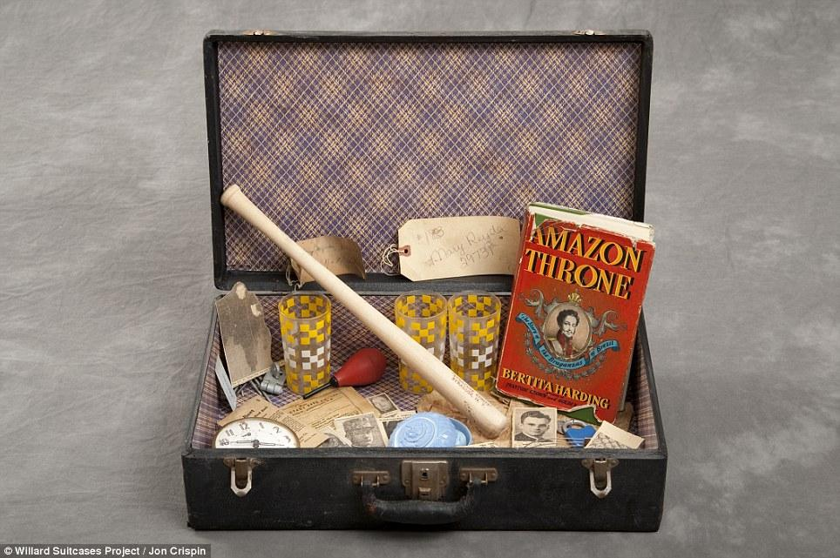
<<< When the Willard Asylum closed in 1995, workers found hundreds of the patients abandoned suitcases in the loft.
Crispin got permission to photograph the cases and the possessions they countained.
Jon Crispin

Slide 32
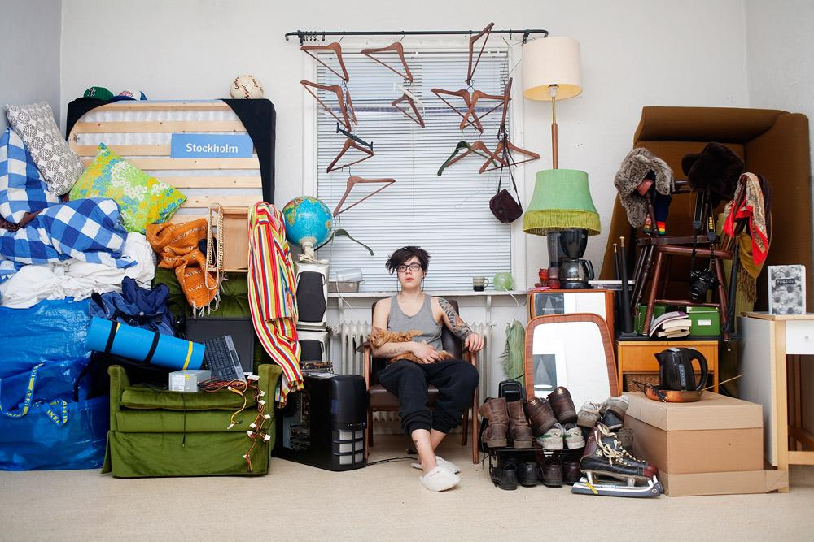
<<< Kvist got people to pose with every object they owned!
Sannah Kvist
‘All I Own’

Slide 33
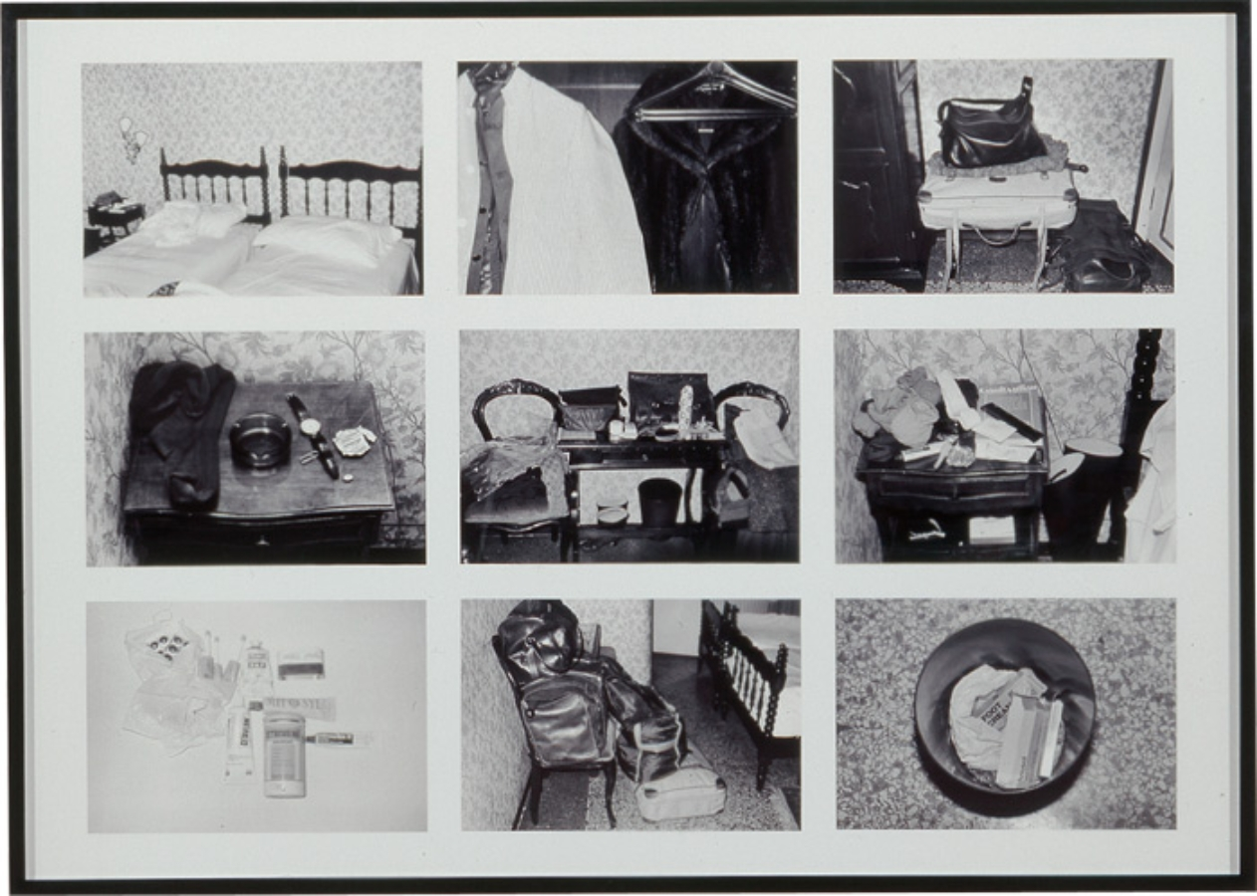
<<< Calle got a job as a chambermaid in a hotel and then when in peoples rooms would photograph their posessions!
Sophie Calle

Slide 34
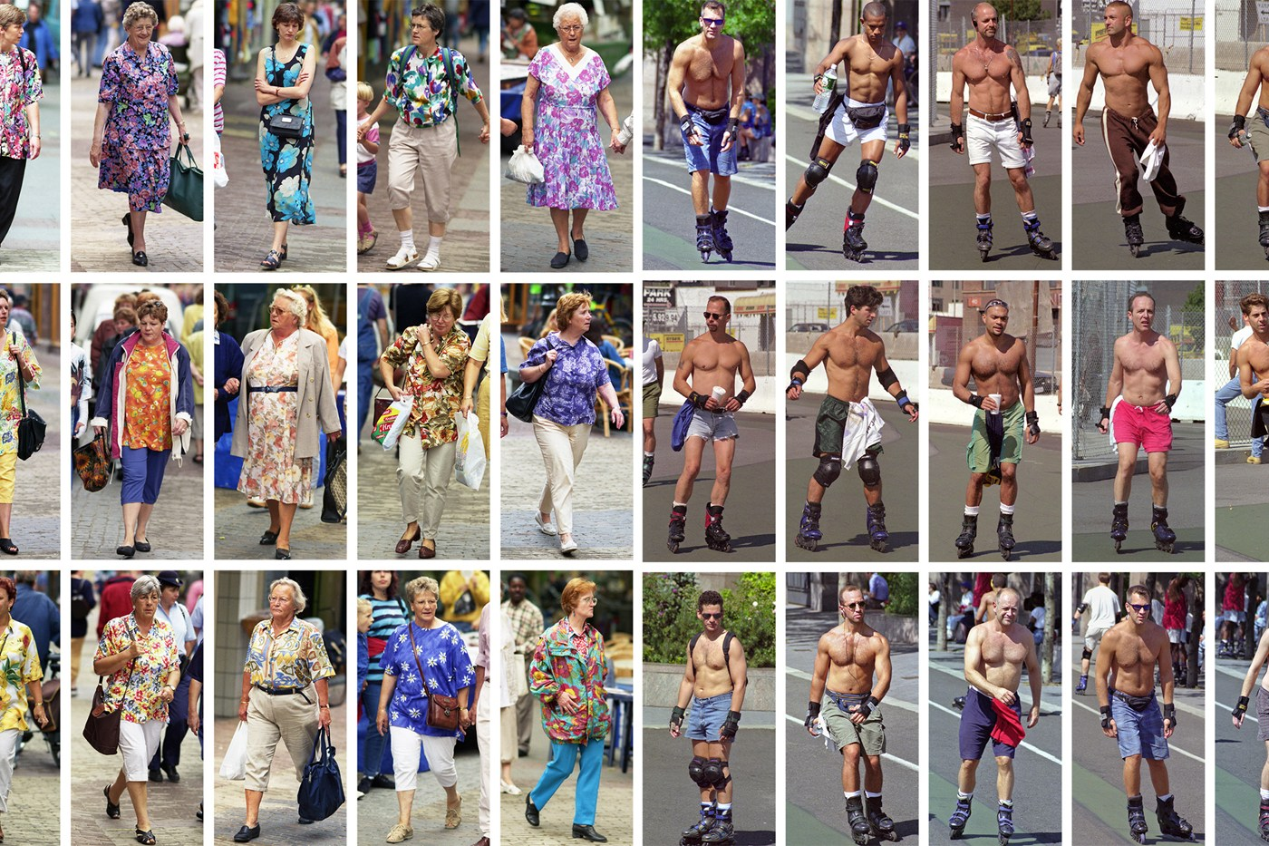
<<< This photographer tries to get images of people wearing the same items in a short space of time.
He spends 1 hour in a location to gather a typology of a particular style.
Proof nobody is unique!
Hans Eijkelboom

Slide 35
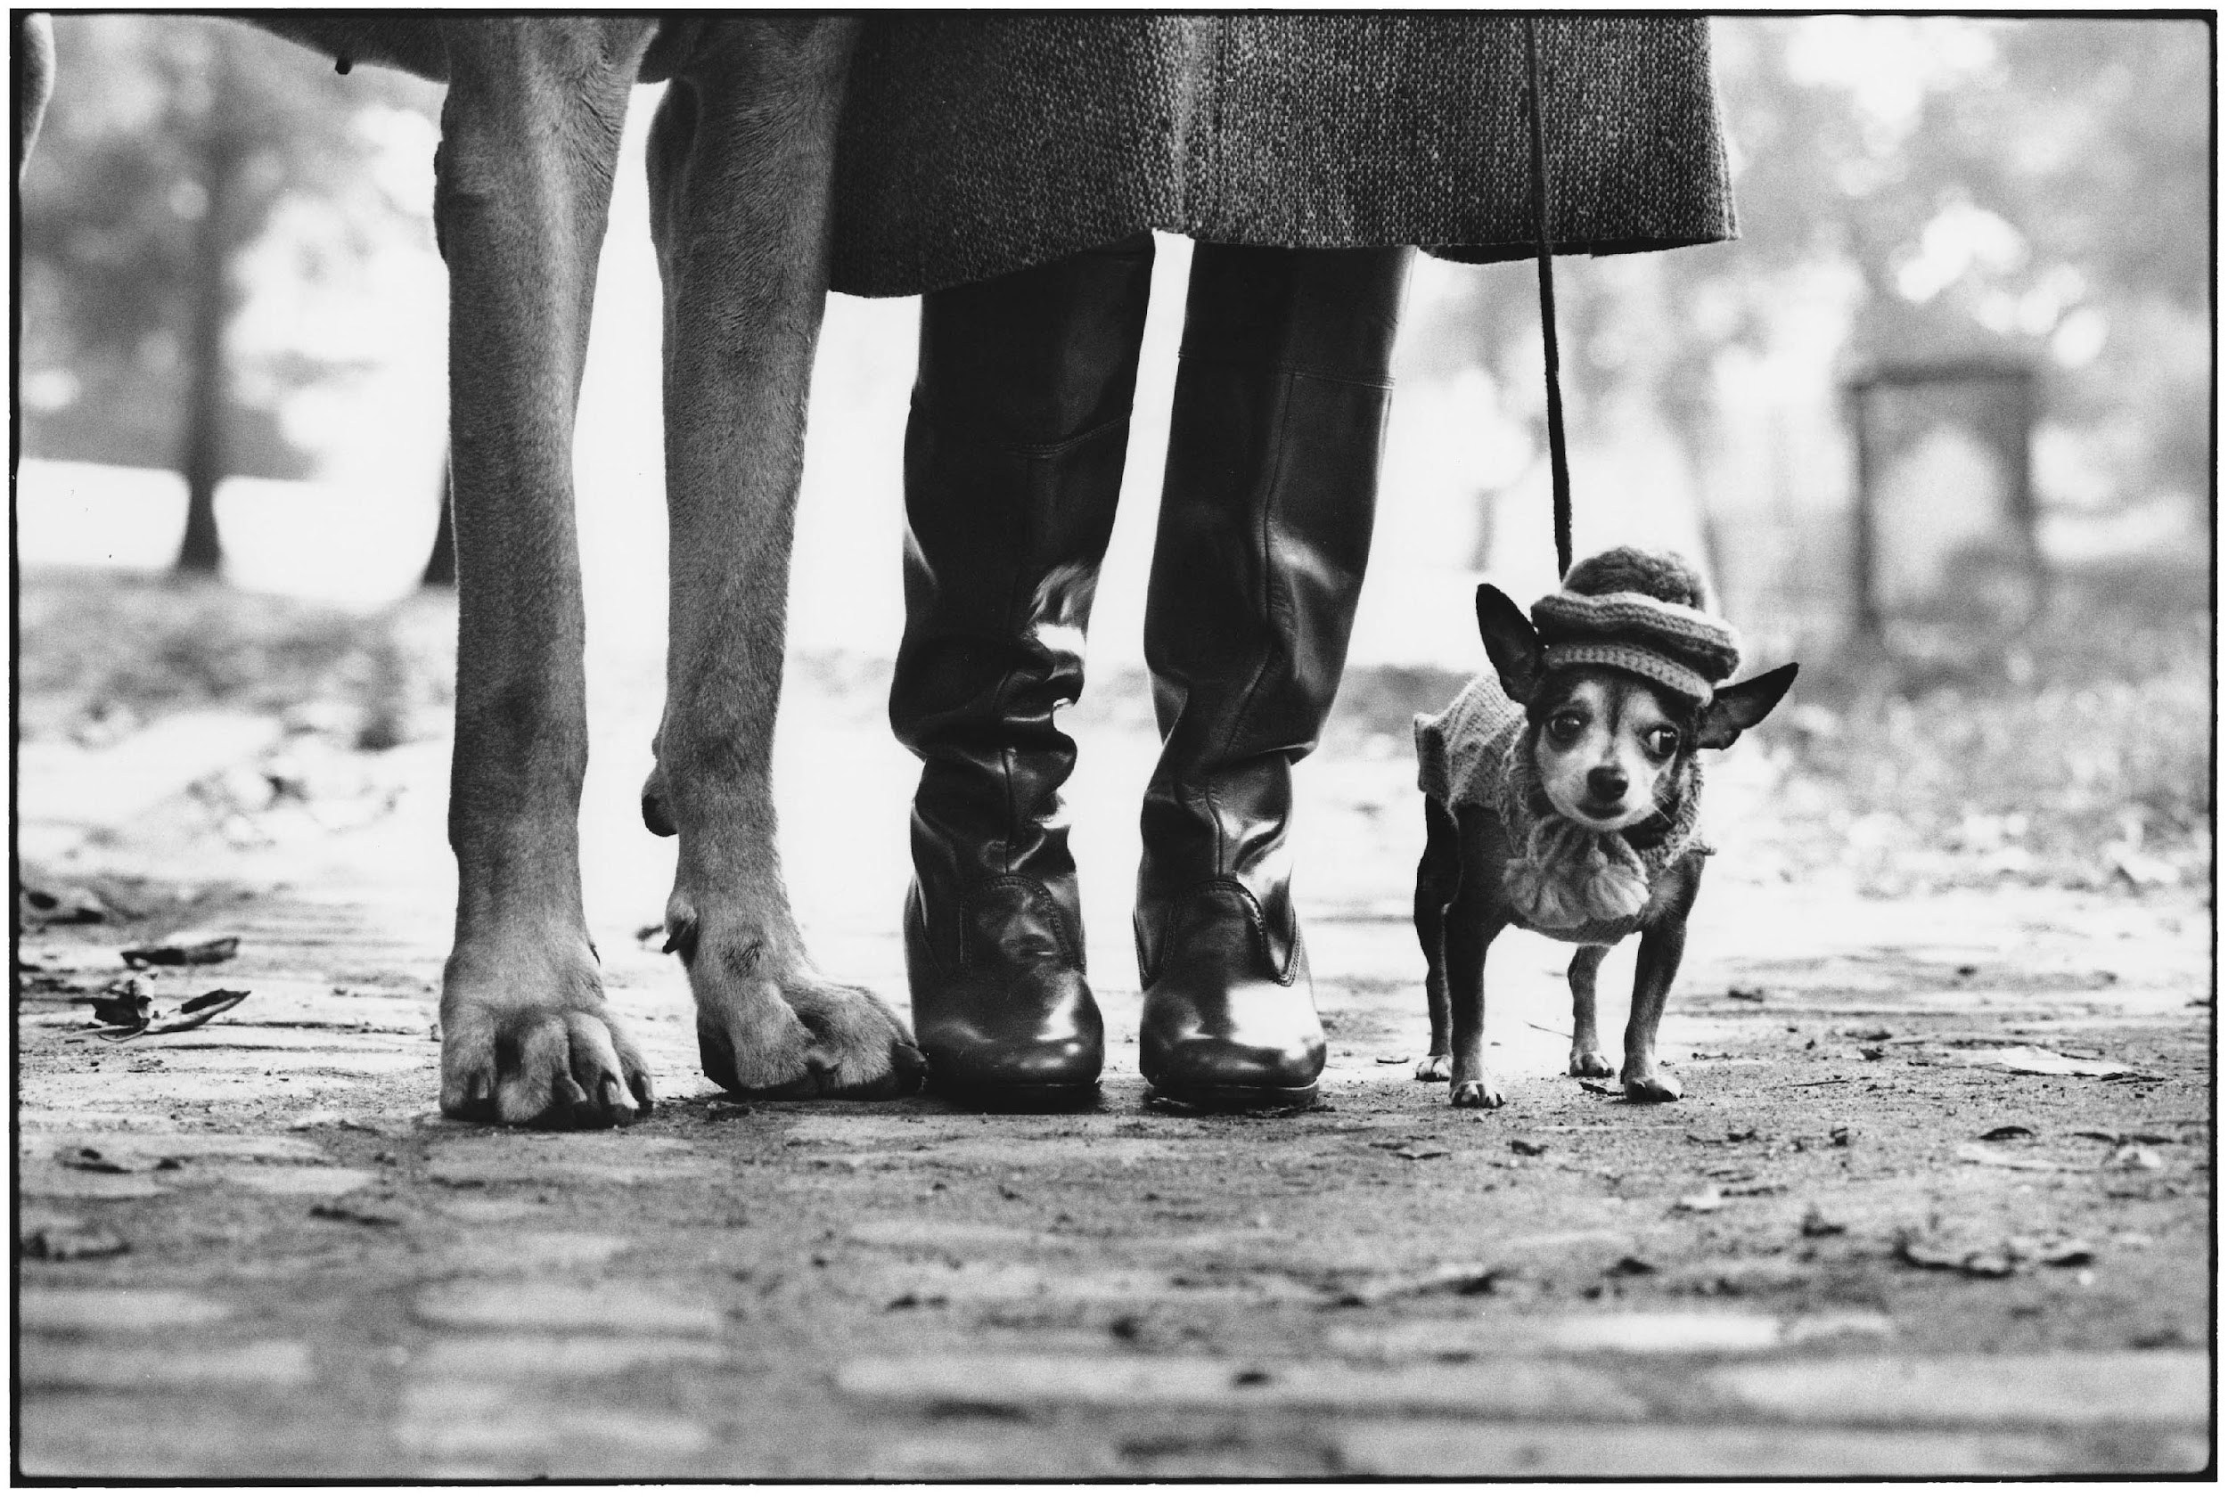
<<< Erwitt’s seminal project where he photographed people and their dogs.
Are dogs possessions?
Elliott Erwitt

Slide 36
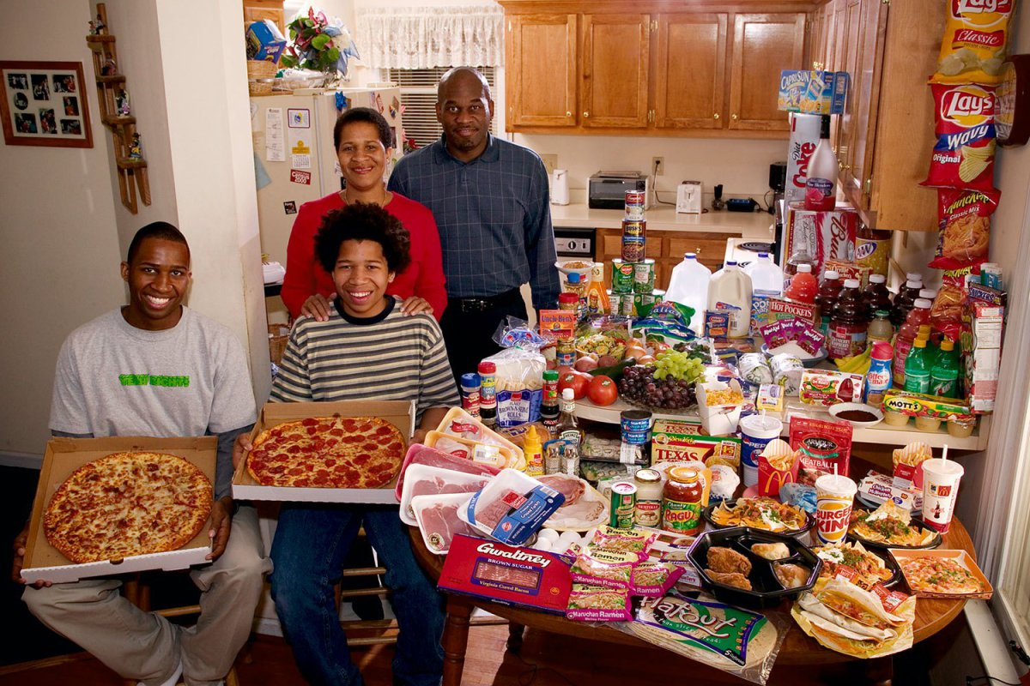
<<< Travelling to 24 countries, Menzel photographed families with their weekly shop and presents the images with how much they spent on their weekly food.
This is the Revis family from N Carolina coming in at £219!
Peter Menzel – hungry planet

Slide 38
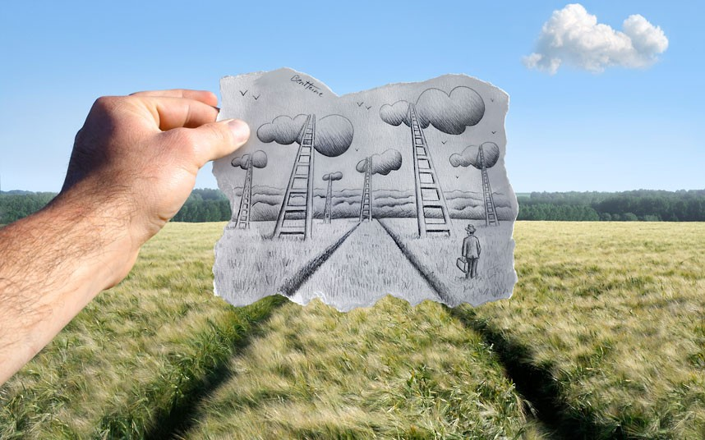
<<< Lovely simple concept to combine cartoon drawings with photographs.
Ben
Hein

Slide 39
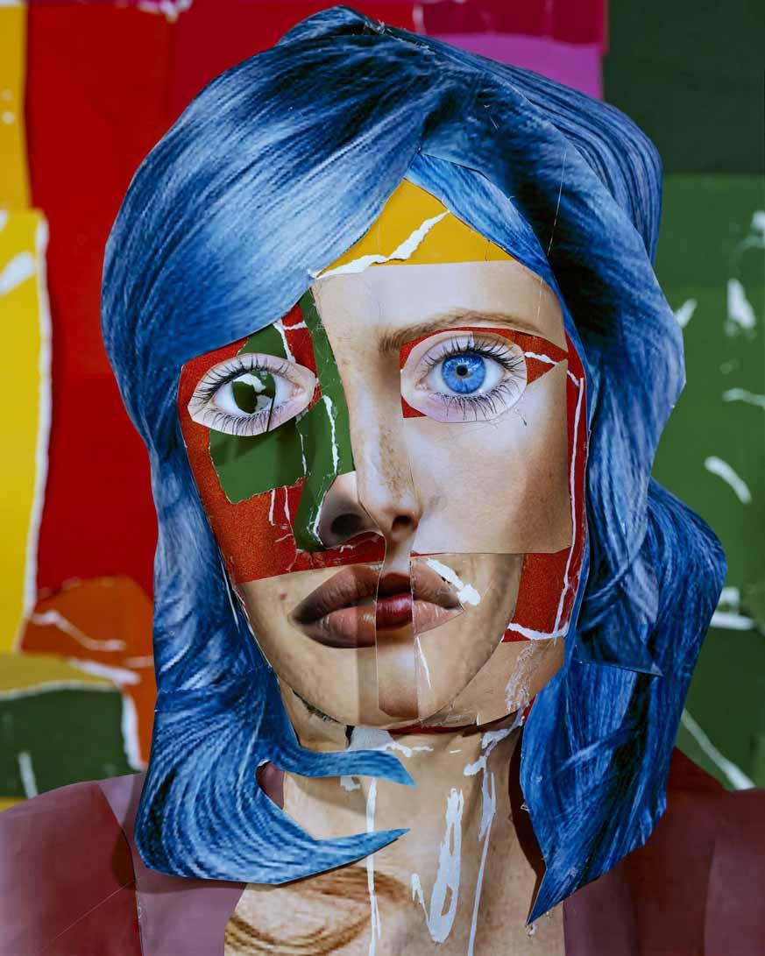
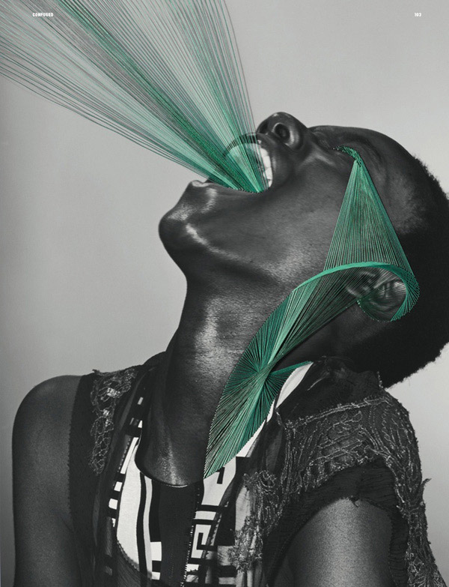
Mixed media and fashion photography is bang on trend!
Gordon uses cut and paste methods to create strange faces and Anzeri
Stitches onto the photographs.
maurizio anzeri
Daniel Gordon

Slide 40
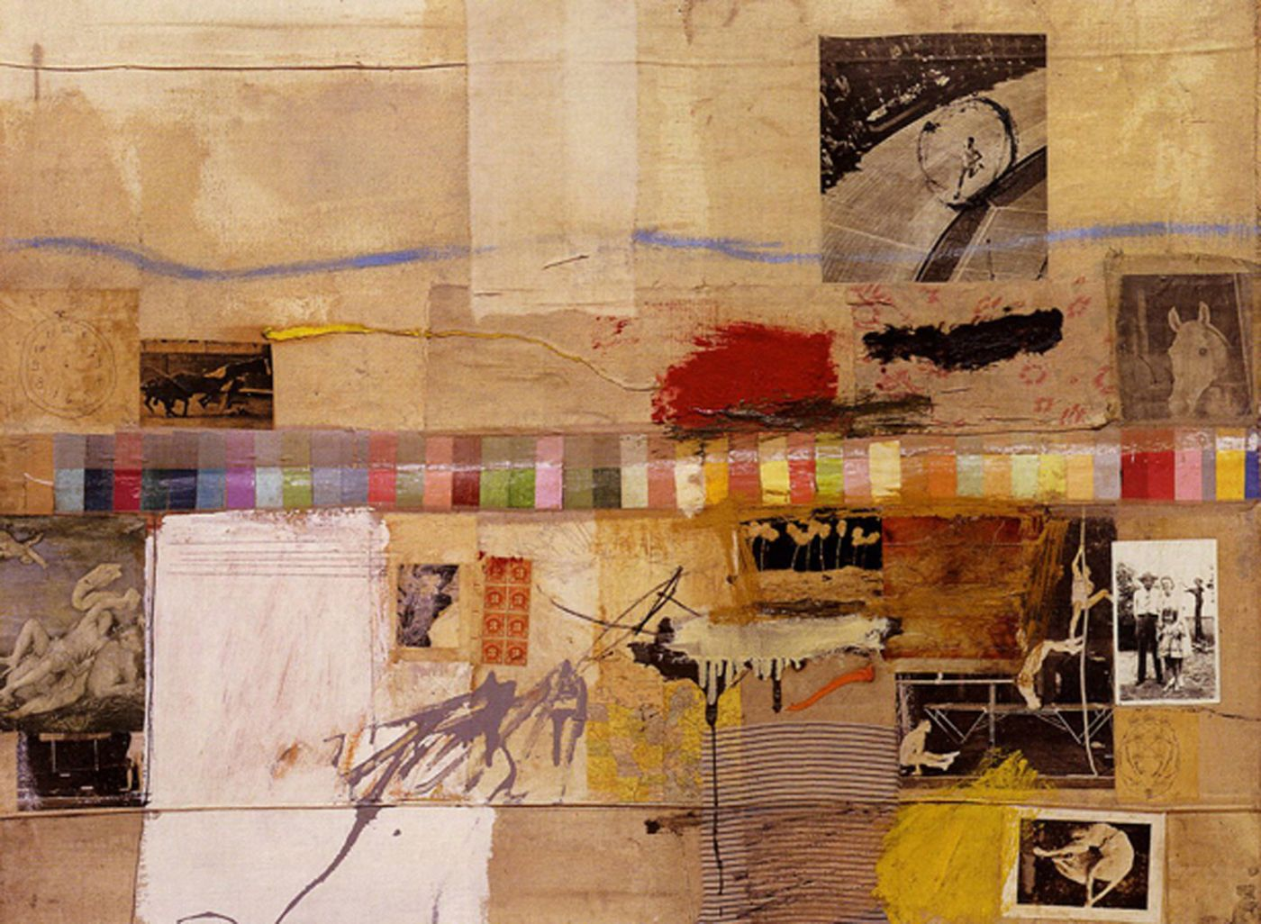
<<< Painter, Photographer, Collage artist – Rauschenberg works in many disciplines and often combines them in his work.
Robert Rauschenberg

Slide 41
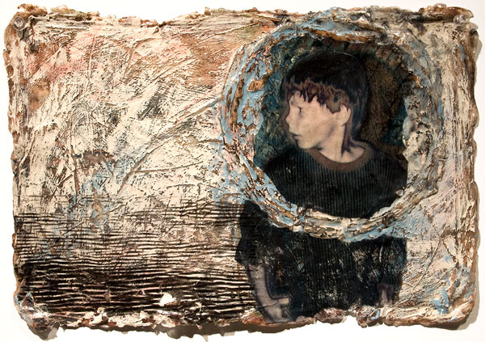
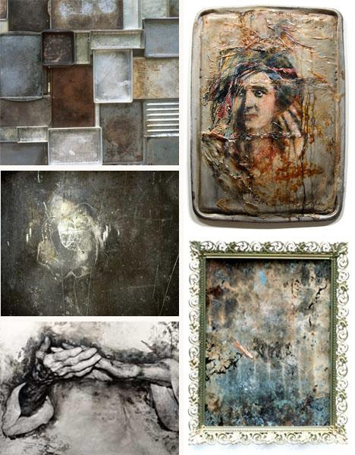
Mankus works with photographs and paint as well as alternative printing techniques to create these images.
<<<
Sally Mankus

Slide 42
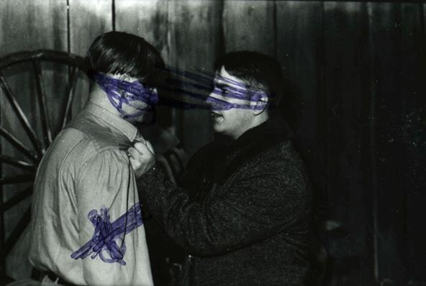
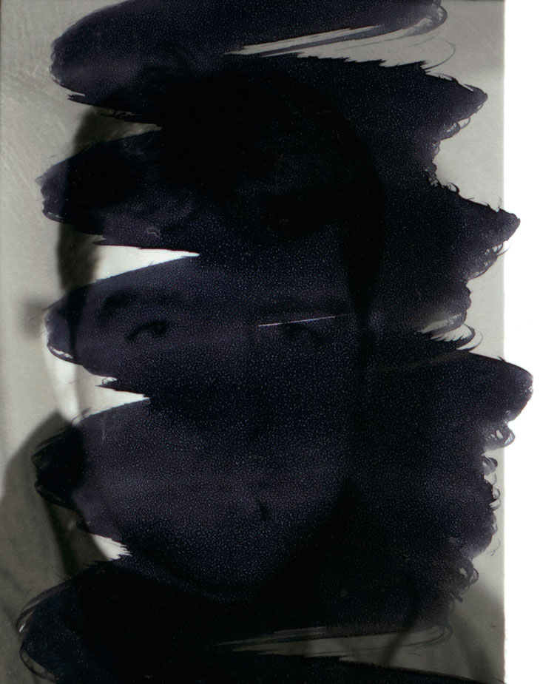
The big names in ‘Anti-Photography’ Broomberg and Chanarin often destruct the surface of images and use found images. Their work often has a political / social meaning.
Adam Broomberg and Oliver Chanarin

Slide 43
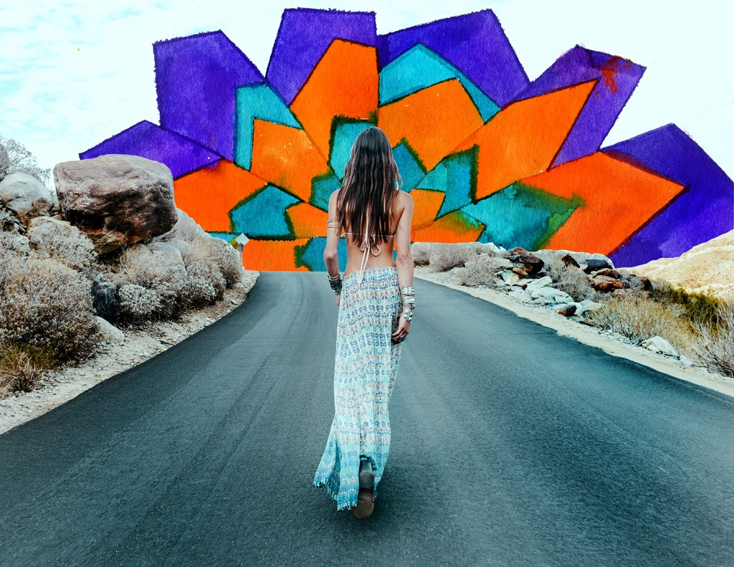
<<< Another great example of how to create effective portrait or fashion work with mixed media.
Collage, ink, paint, drawing, stitching, cutting, pasting, combining, removing, adding – there are endless methods to explore.
Alexandra Valenti

Slide 44
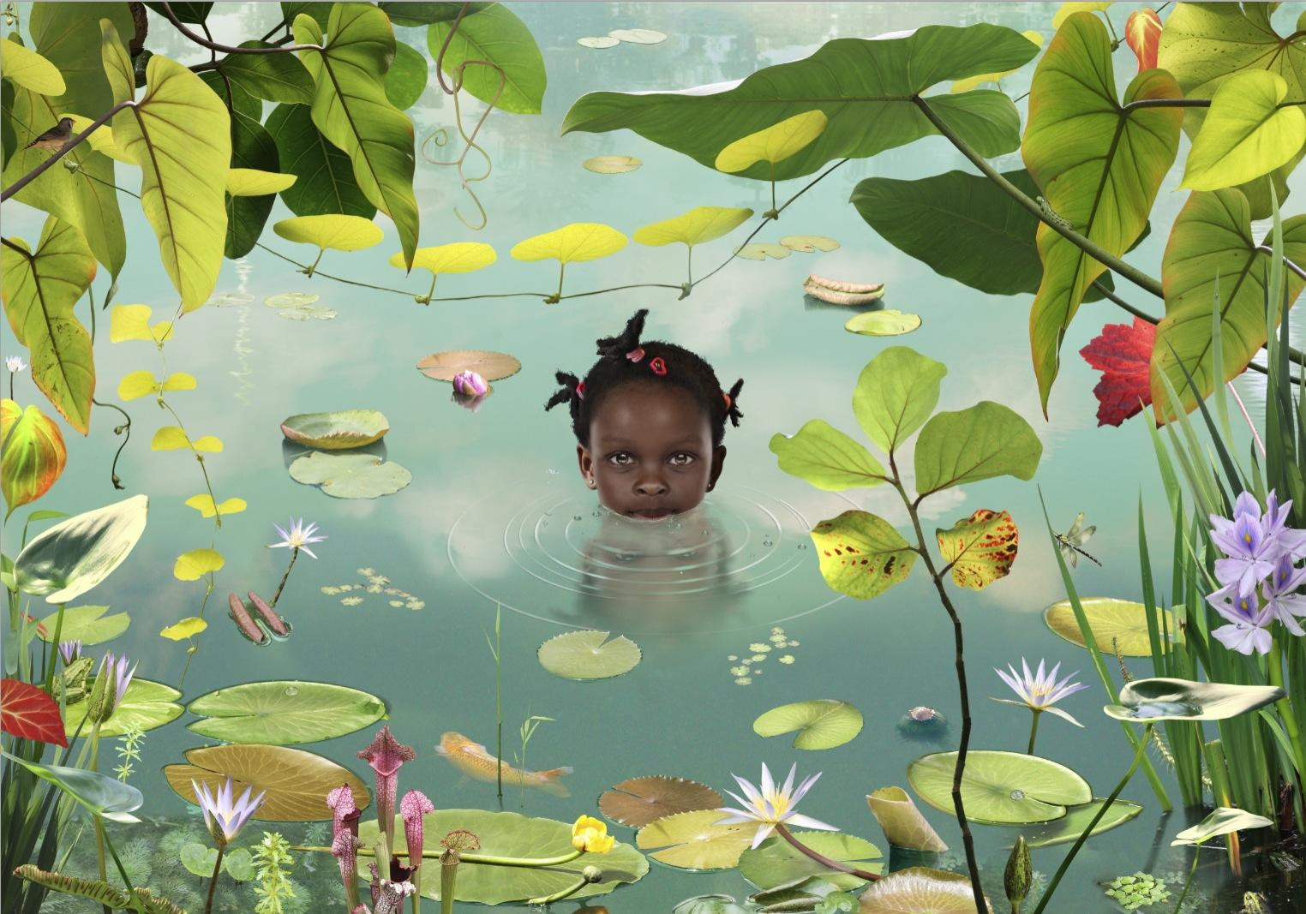
<<< Surreal and wonderful mixed media images created by this Dutch artist. They look like illustrations but are photographically based.
Ruud Van Empel

Slide 45
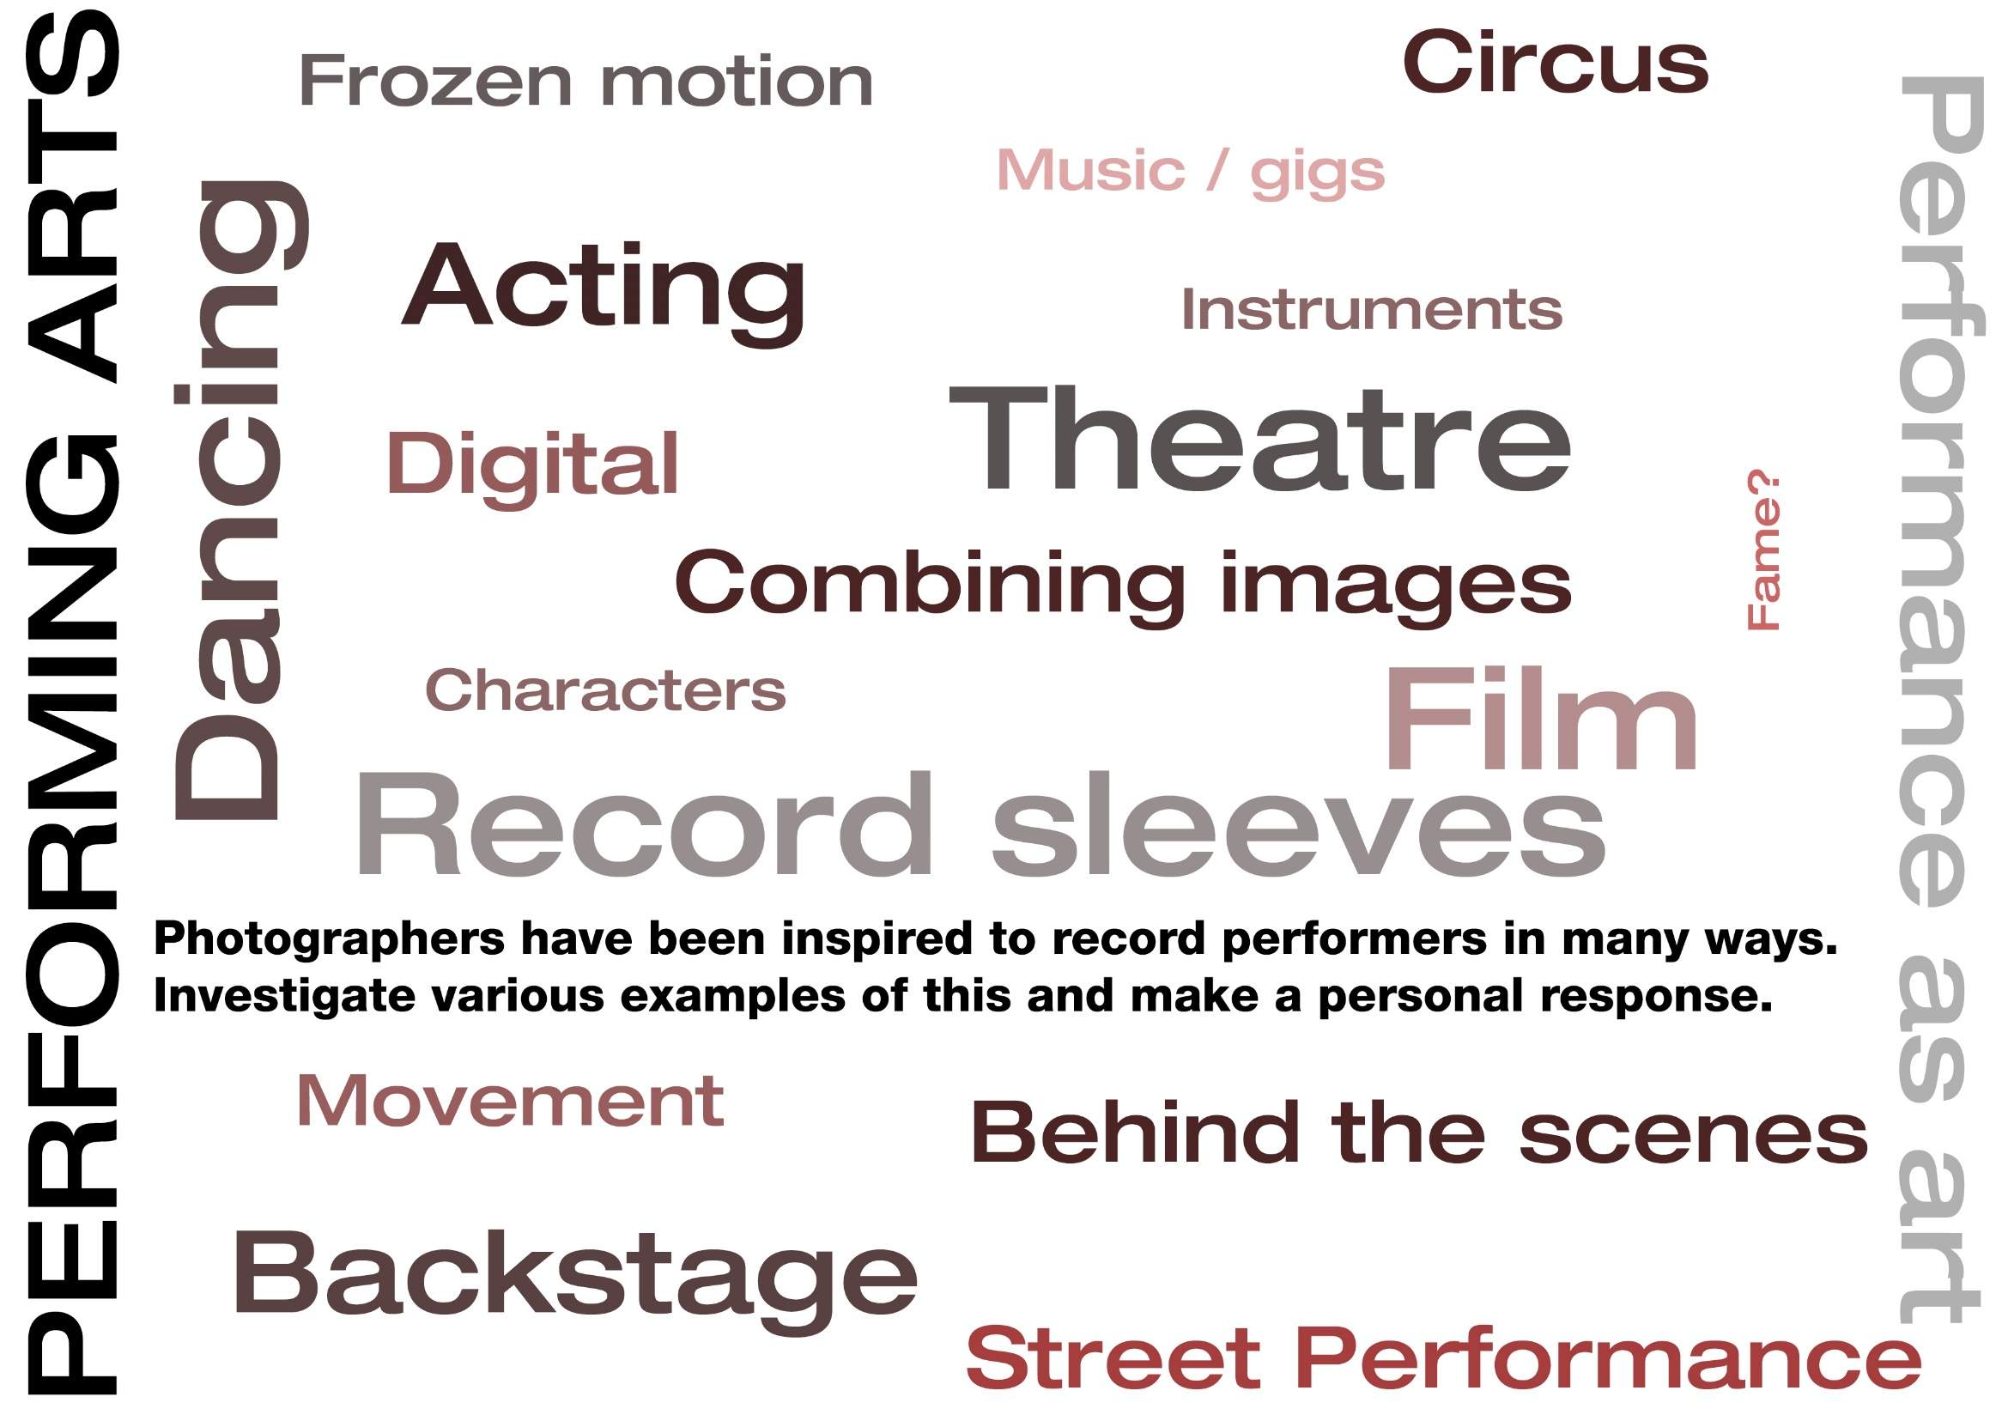

Slide 46
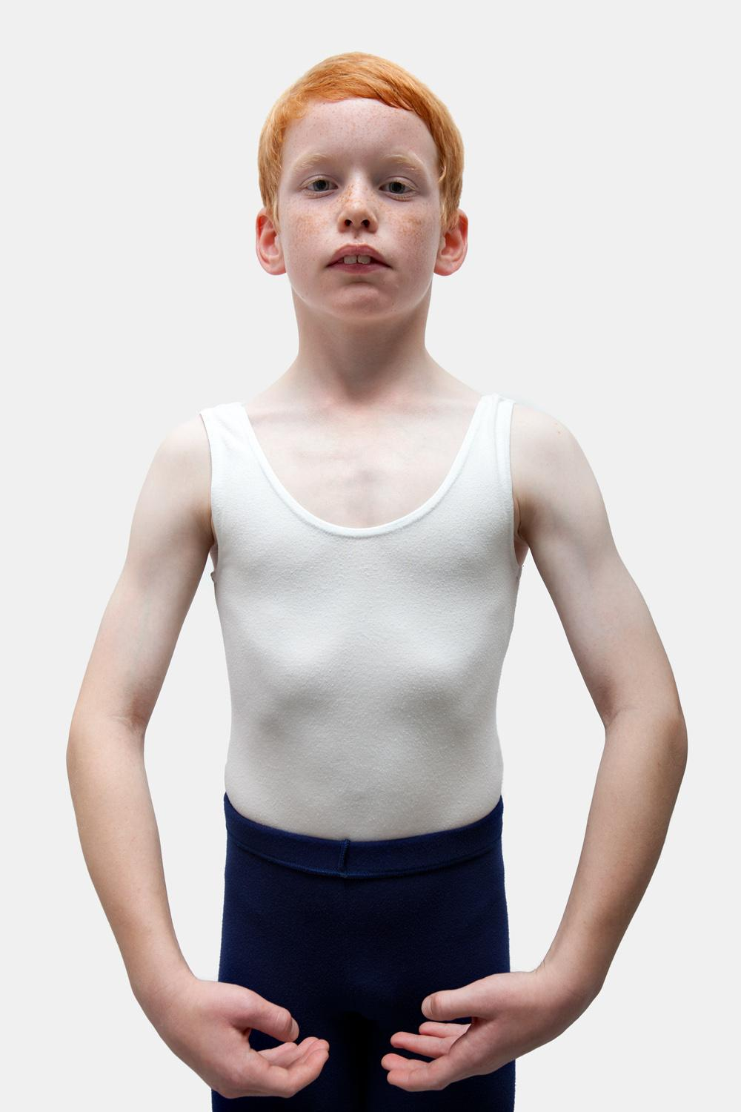
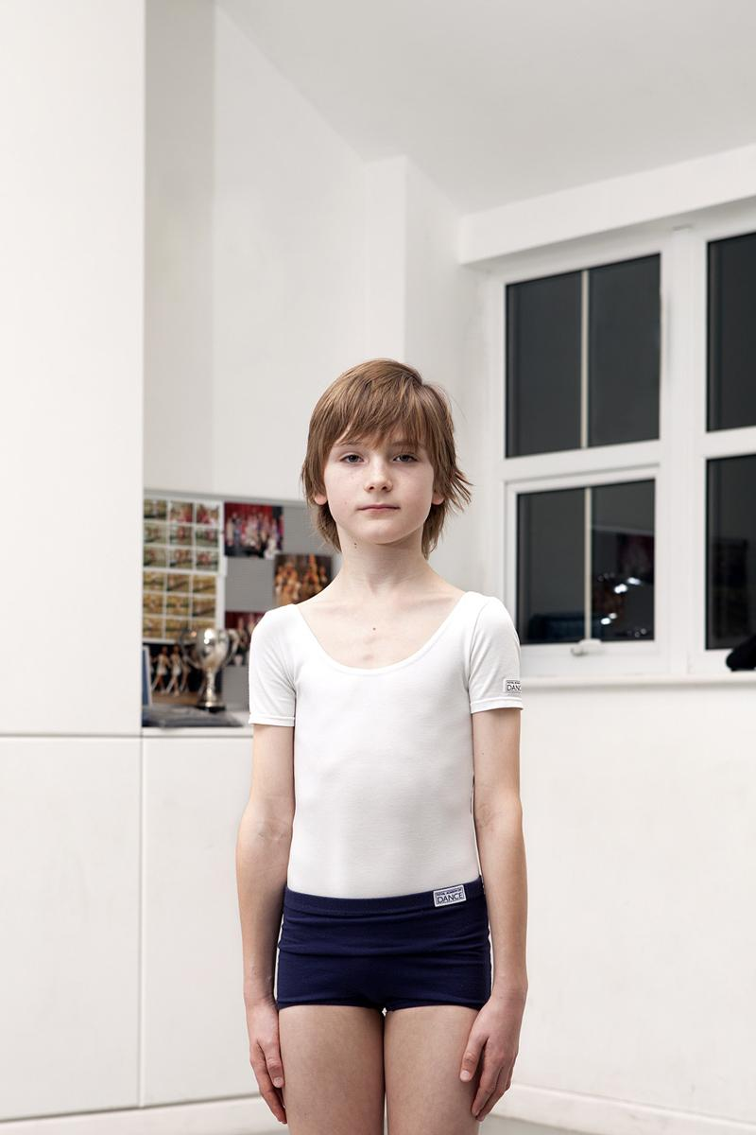
<<< Town’s lovely series documenting boys who do Ballet.
Matthew Town
Ballet Boys

Slide 47
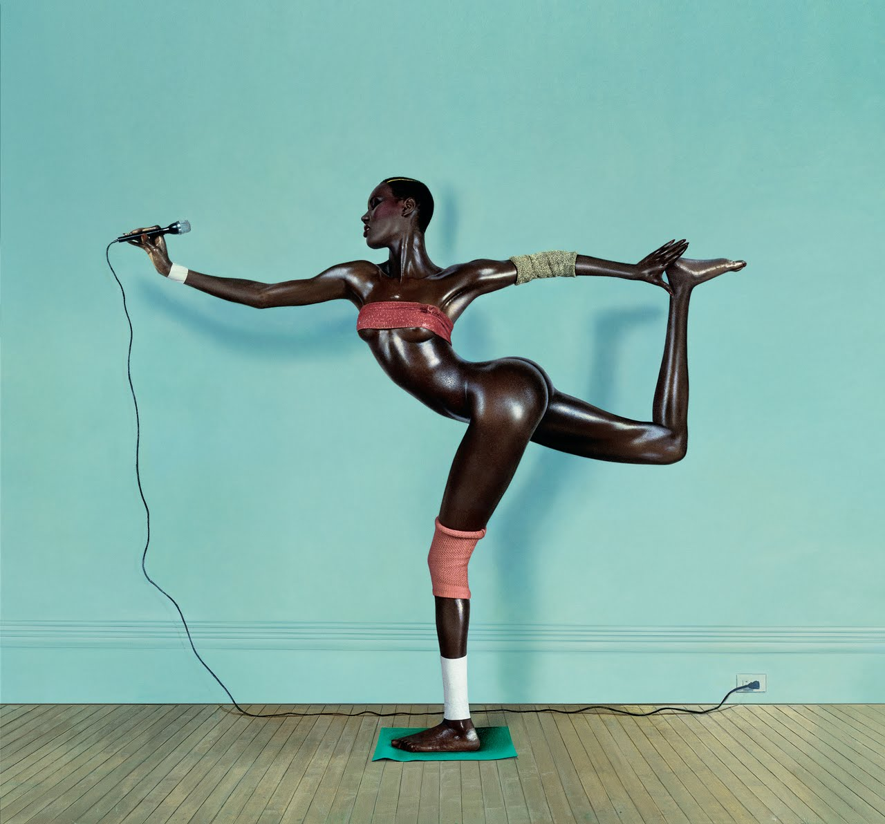
<<< This is an iconic image of Grace Jones, used for an album cover.
He created numerous images of the model, singer and performer.
Jean-Paul Goudethe

Slide 48
This series was entirely shot on location in film studios. It documents the view we normally do not see behind the camera.
Ben Gold
Behind the Scenes

Slide 49
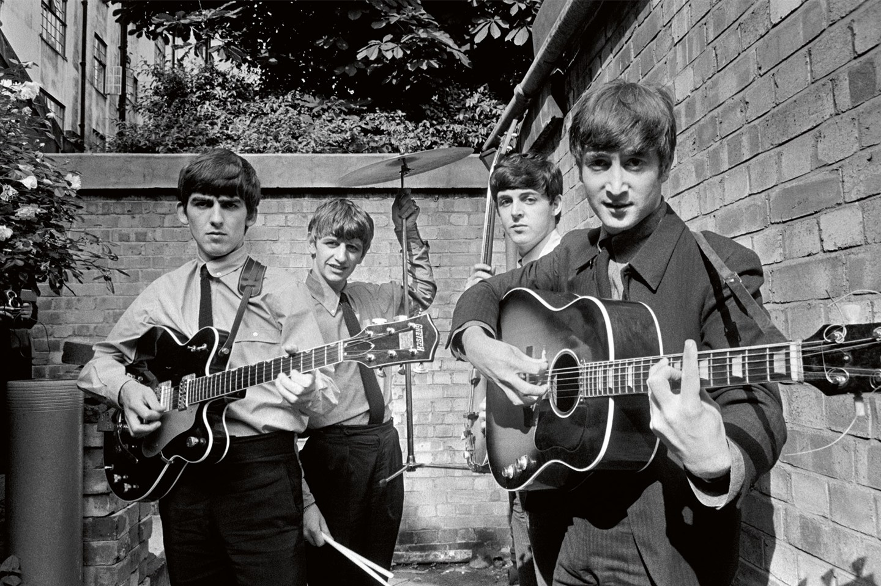
A very young Beatles! Shot by O’Neil who made portraits of numerous musicians and performers.
Terry O’Neil

Slide 50
<<< Dance photography at its best!
You would need: A studio with flash lighting, fast shutter speeds and very able dancers…plus the decisive moment of course!
Lois Greenfield

Slide 51
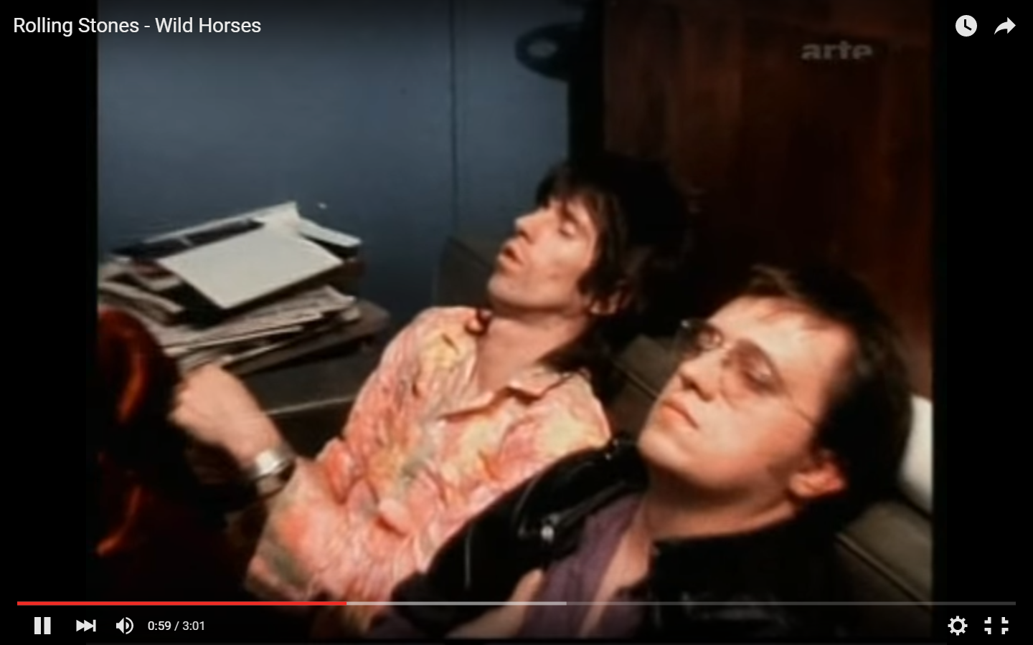
Clip from the documentary about the Rolling Stones ‘Gimmie Shelter’ by Albert and David Maysles. Footage of them listening to the playback of a recording they have just done. CLICK IMAGE FOR VIDEO LINK.
<<<

Slide 52
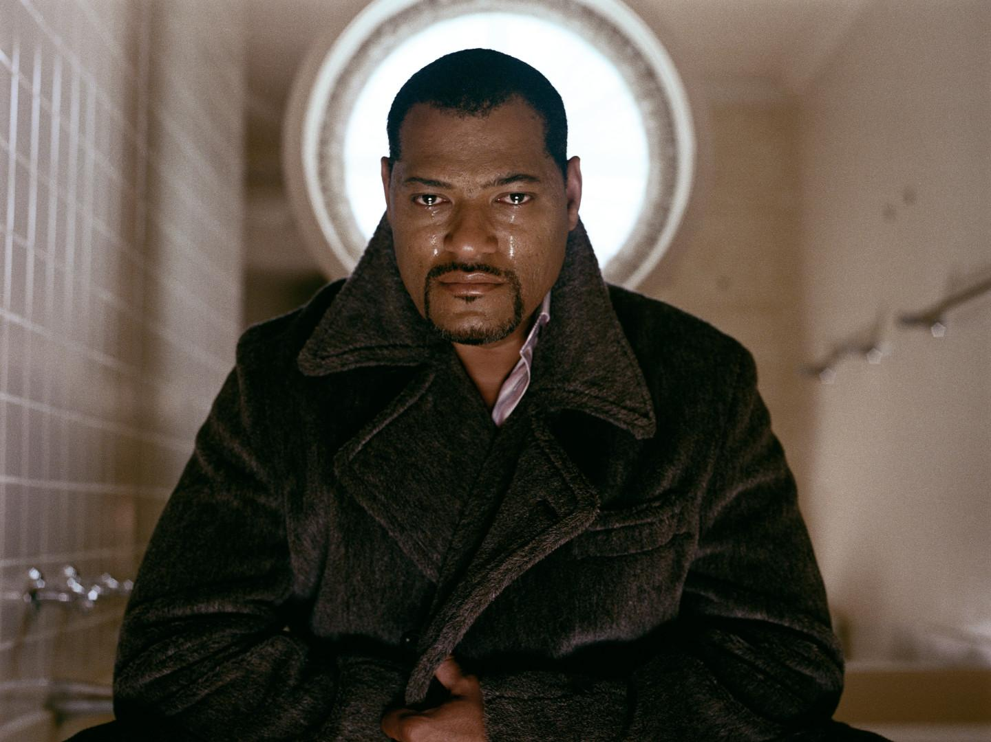
<<< Portaits of performers who are performing the act of crying.
Simple yet poignant series.
Sam Taylor Wood
Crying Men series

Slide 54
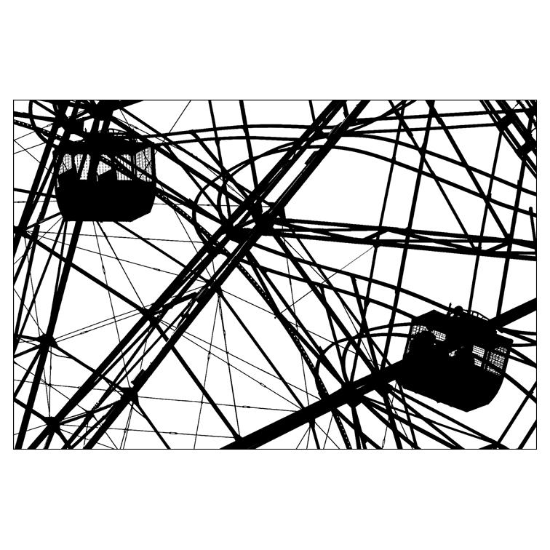
Patterns spotted in the urban landscape through clever cropping or combining.
Nathan Harger

Slide 55
Alongside his fashion work, Horst created these images of patterns in nature. Each image is repeated and flipped to create an endless repeat like a kaleidoscope.
Horst

Slide 56
Steven Meisel
Very jazzy fashion!
SYNCHRODOGS

Slide 57
Use of multiple imagery within the darkroom to make a pattern from single images.
Geraldo de Barros

Slide 58
<<< Blakemore creates stunning silver prints of plants and leaves, first carefully arranging them to make the perfect composition.
John Blakemore

Slide 59
<<< Patterns can be created at the presentation stage of your work as seen in Liz Orton’s landscapes.
Liz Orton

Slide 60
<<< Hilla Becher sadly passed away last year – what better way to pay tribute to their seminal work than considering the patterns created through a typology project?
Bernd and Hilla Becher

Slide 62
<<< Rosella’s powerful project explores the issue of teenage pregnancy through these intimate portraits.
Issues are all around you, find something you are passionate about and usually people will be willing to be involved!
Raphaela Rosella

Slide 63
<<< Jo Spence used photography to help come to terms with her struggle against breast cancer.
Jo Spence

Slide 64
<<< Burtynsky has been interested in the oil industry and its effect on the world.
He has photographed it in many ways, including the waste products.
Edward Burtynsky

Slide 65
<<< Pillot’s amazing photographs of animals in zoos.
You do not necessarily have to have an opinion to create a project about a topic – you just need to be curious and open minded in how you explore it visually.
ERIC PILLOT

Slide 66
Tony Ray-Jones is the photographer who Martin parr cites as a true genius! In his short career he observed the British at work and play.
<<<
Tony Ray-Jones

Slide 67
<<< Emerson documented rural life in the late 19th Century as a way of preserving a lifestyle he saw vanishing.
Peter Henry Emerson

Slide 68
<<< Stunning images about poverty in Romania.
A perfect set of colours and light in each image really helps to captivate the emotion.
Tamas Dezso

